Slide 1
Self Care for Wellness
Anuja Sharma & Maureen Pollard

Slide 2
Self-Soothing vs Self-Care
Distract and Comfort
Grounding and Growth
Notes:
Q.1

Slide 3
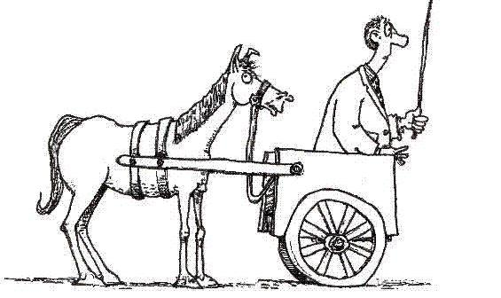
Disordered Healthcare
Self Care
Medicine
Surgery
Notes:
Q.2

Slide 4
Notes:
Q.3

Slide 5
Health
Self Care
Surgery
Medicine

Slide 6
Notes:
Q.5

Slide 7
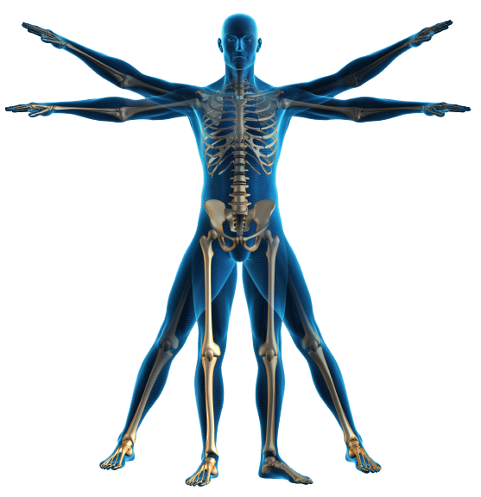
12 Self Care Pillars
Soul
Presence
Gratitude and Kindness
Discomfort
Mind
Maintenance
Learning
Growth
Body
Sleep + Rest
Nourishment + Hydration
Movement
Connection
Self
Others
Nature
Notes:
Q.6

Slide 9
Barriers to Self Care
Being other focused
Identifying with roles and responsibilities.
Prefrontal hijack due to stress
Thinking it will take too much time
Belief that it is hard/unpleasant
Notes:
Closing

