Slide 1
Ancient Wisdom with Today's food
Dr Deepa Bhargava MBBS, MS

Slide 4
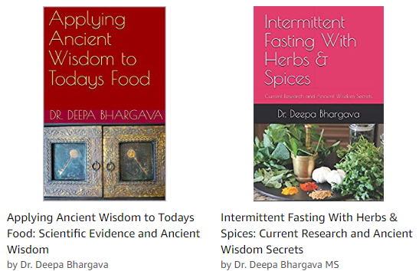

Slide 5
Objective
The basics of the new Canada Food Guide
A step further – Scientific evidence and Ancient wisdom.
Personalized Nutrition
From knowledge to Action -Actionable steps

Slide 6
Talk outline
Today’s Food and Its Impact on Our Health. Food Macronutrients and Micronutrients
Understanding Relationship of Food, Microbiome, Probiotics and Prebiotics
Ancient Ayurvedic Wisdom
How to use Real Food &The new Canadian food guide
Developing a Customized Action Plan

Slide 7
New Canadian food guide
Guideline 1 recommends
Vegetable, fruit, whole grain form basis.
Protein food should be consumed regularly among the protein food plant-based protein food should be the choice these protein food include legumes, nuts seeds, tofu

Slide 8
Guideline 1 (cont )
Animal protein can include- fish, shell fish, eggs, poultry, lean red meat including wild meat, low-fat milk, low-fat yogurts, low-fat kefir and cheese lower in fat and sodium.
Foods that contain mostly unsaturated fat should replace foods that contain saturated fat
water should be the choice beverage

Slide 9
Guideline 2
Processed or prepared food and beverages that contribute to excessive sodium, free sugars or saturated fats undermine healthy eating and should not be consumed regularly.
People are encouraged to consume home cooked meals .

Slide 10
Guideline 3
Food skills are needed to navigate the complex food environment and support healthy eating
Cooking and food preparation using nutritious food should be promoted as a practical way to support healthy eating
People should maintain their food traditions
Mindful eating is encouraged .

Slide 11
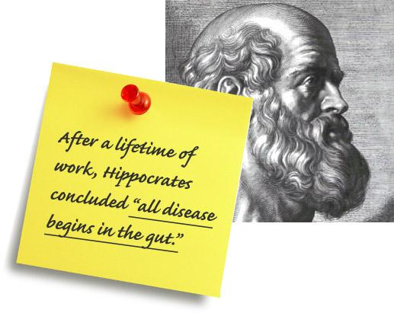

Slide 12
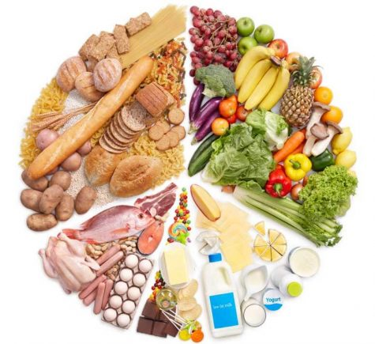

Slide 13
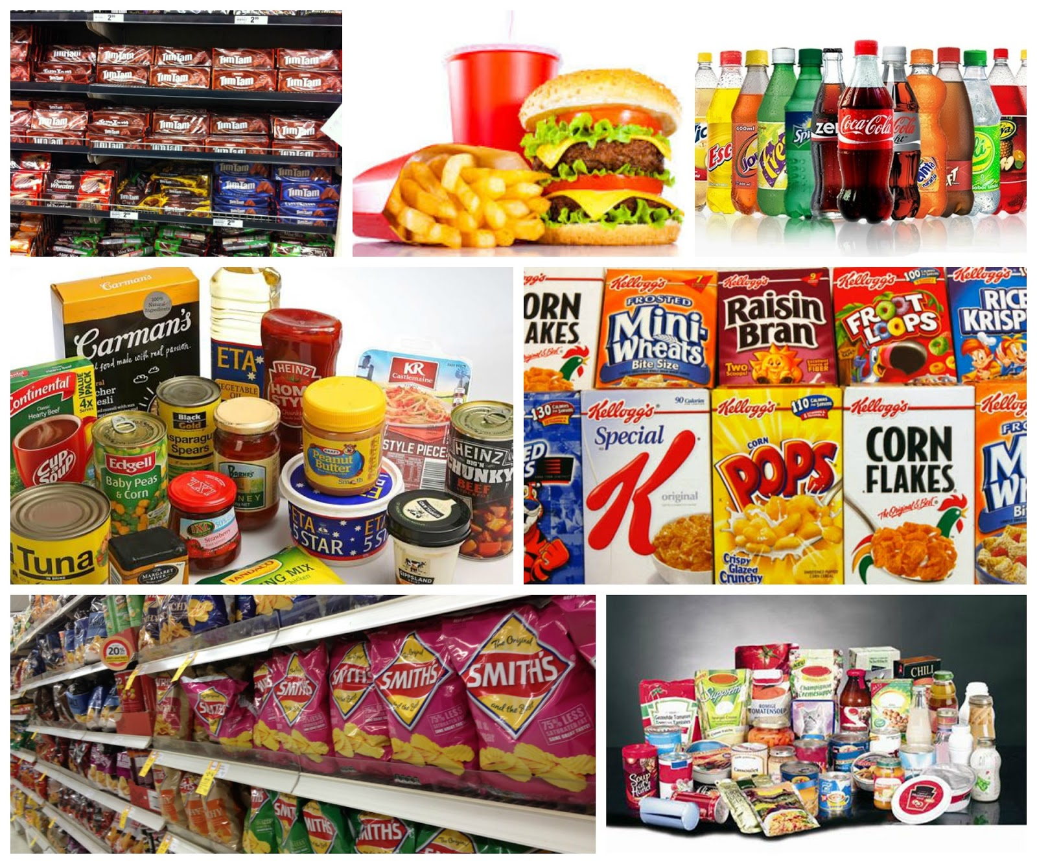

Slide 15
Today's food
Genetically modified vegetable oils with poisonous trans fats
Eggs - cages, fed GMO, hormones, antibiotics
Milk -GMO cows, hormones, antibiotics GMO Grains. pasteurized with many additives.
Meat laden with antibiotics, hormones from animals caged and raised on GMO grains

Slide 16
Today's food
GMO Fish raised in tanks and fed GMO pellets.
Artificial meat, lab meat and so many more
Genetically modified pesticide laden fruit and vegetables
Genetically modified grains wheat, soy, corn and rice

Slide 17
Processed Food and Additives
A lot of processed food is created in the lab coming to think of it, it is not real food but a product which labeled as food e.g cheese
MSG and its aliases
Preservatives
Stabilizers
Food colors

Slide 18
Food Macronutrients and Micronutrients

Slide 20
Understanding Relationship of Food, Microbiome, Probiotics and Prebiotics
Functional food
Probiotic
Prebiotics
Symbiotic
Microbiome

Slide 21
Research EXPLOSION
10 X our own cells
Microbiome = a complex “organ”
100 to 1,000 times more DNA than ours!!!
20,000 functions & make 100’s of thousands of biochemicals
Genes for making hormones, enzymes, etc.
Humans = 23,000
Microbes = 4.5 million!

Slide 22
Definition
The World Health Organization defines probiotics as “live organisms, which, like bacteria and yeasts, when ingested in adequate amounts, exert health benefits in the host via the intestinal flora.”

Slide 23
Introduction
History -

Slide 24
Microbes explain why…
One twin can be thin, one fat on the same diet
Some diets (e.g. Mediterranean) are healthful
Blood sugar response varies with the same food

Slide 25
Microbes also explain why…
Why males are more prone to emotional problems if mom stressed early in pregnancy
Some people get kidney stones and others eating the same foods do not
And so many other medical mysteries

Slide 26
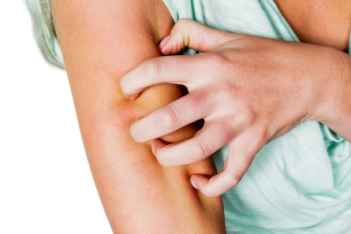
Research (non-digestion)
ALLERGY / SENSITIVITY
Asthma
Autoimmune thyroid
Bronchitis
CARDIOVASCULAR
Blood pressure
Cholesterol
Heart failure
TMAO levels

Slide 27
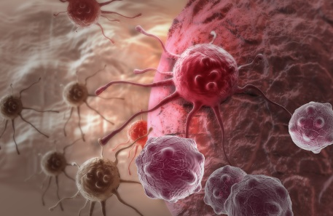
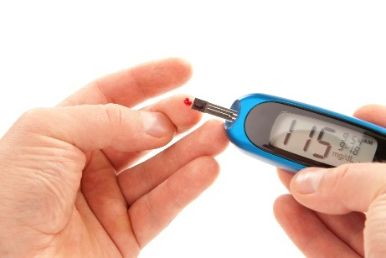
and…
CANCER
Bladder
Breast
Cervix
Kidney
Prostate
Stomach
Cholesterol
Colds & flu
Diabetes, Type 1 and 2

Slide 28
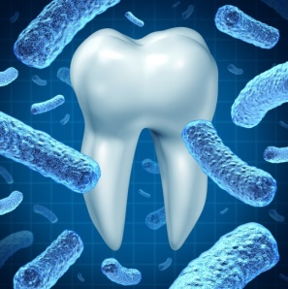
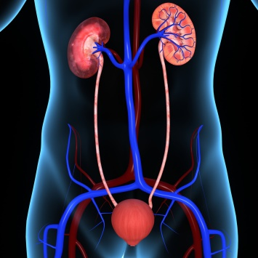
more…
Fatigue
Gum Disease / Decay
Kidney Disease & Stones
Obesity
Psoriasis
Sinusitis
UTI’s-Vaginal Yeast

Slide 29
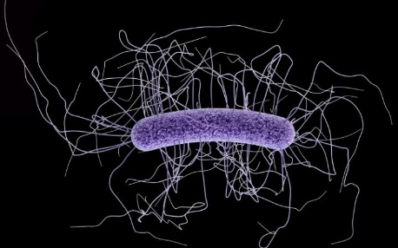
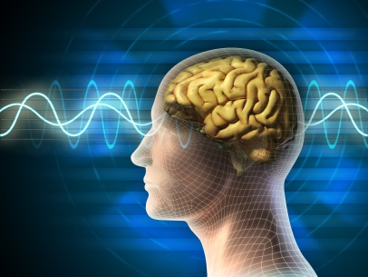
Gut—Brain / Nerves / Mood
Anxiety
Autism
Alzheimer’s
Brain Injury
Depression
Mental Illness
Multiple Sclerosis
Stress

Slide 30
HOW do they do it ???
Change how our genes behave
Alter genes of other microbes
Reduce inflammation
Reduce hormone excess
Help immune function
Help prevent / reverse leaky gut

Slide 31
What kills friendly bacteria ?
What is bad for us is bad for them
Antibiotics
Chlorine in water
Pesticides & herbicides
Industrial chemicals
Some food additives
Stress, inactivity, anger, etc.

Slide 32
Probiotic functional food of Ancient cultures
Bulgarian - Kefir
Korean- Kimchi
Chinese –Nato
Japanese - Natto and Miso
Indian – Lassi, Yoghurt, many pickles, drinks
Mediterranean Egyptian -Labneh, pickled vegetables

Slide 33
How can one help the microbiome
Avoid sugar and transfat
Load on raw vegetables (raw plant based whole food diet)
Have natural probiotics with every meal
Supplement

Slide 34
How can one help the microbiome
Hygiene – “Live dirty, eat clean”.
Avoid and be aware of antibiotics- pharmaceutical and food source containing antibiotics
Avoid genetically modified food

Slide 35
Probiotic functional food of Ancient cultures
Bulgarian- Kefir
Korean- Kimchi
Chinese –Nato
Japanese-Nato and Miso
Indian – Lassi, Yoghurt, many pickles, drinks
Mediterranean Egyptian -Labeneh, pickled veges

Slide 36
From knowledge to action.
Five R s
Remove
Replace
Restore
Retrain
Rehabilitate

Slide 37
Remove
Processed food
Sugar
GMO-Wheat, Soy, Corn
MSG- aliases
Plastics
Phytates- washing ,soaking, sprouting
Oxalates
Lectins- Pressure cooking
Low quality animal protein

Slide 38
Replace
Whole food plant based
Wheat, corn, Soy- Ancient grains – buckwheat, Amaranth, Shorgum, Fox tail millet, Quinoa, Flax seed and Chia seeds
Dairy with – nut milk ,oat milk
Animal protein with plant based protein –Lentils and beans
Sugar- Whole fruit

Slide 39
Restore - Microbiome
Plant based – Raw food
Diversity of vegetables
Go fermented – Ancient probiotics with every meal –Yoghurt, Kefir, Kimchi, Natto Sourqraut
Avoid sugar, processed food
Avoid Antibiotics
Supplement if needed

Slide 40
Retrain
Retrain – learn more about nutrition – books, Web, seminars
Learn how to prepare home made Ancient probiotics
Upgrade cooking skills – go international learn Ancient food preparation
Mindful eating

Slide 41
Rehabilitate
Recognize food is an addiction
Inactivity
Stress management
Emotional Management
Rehabilitation program

Slide 42
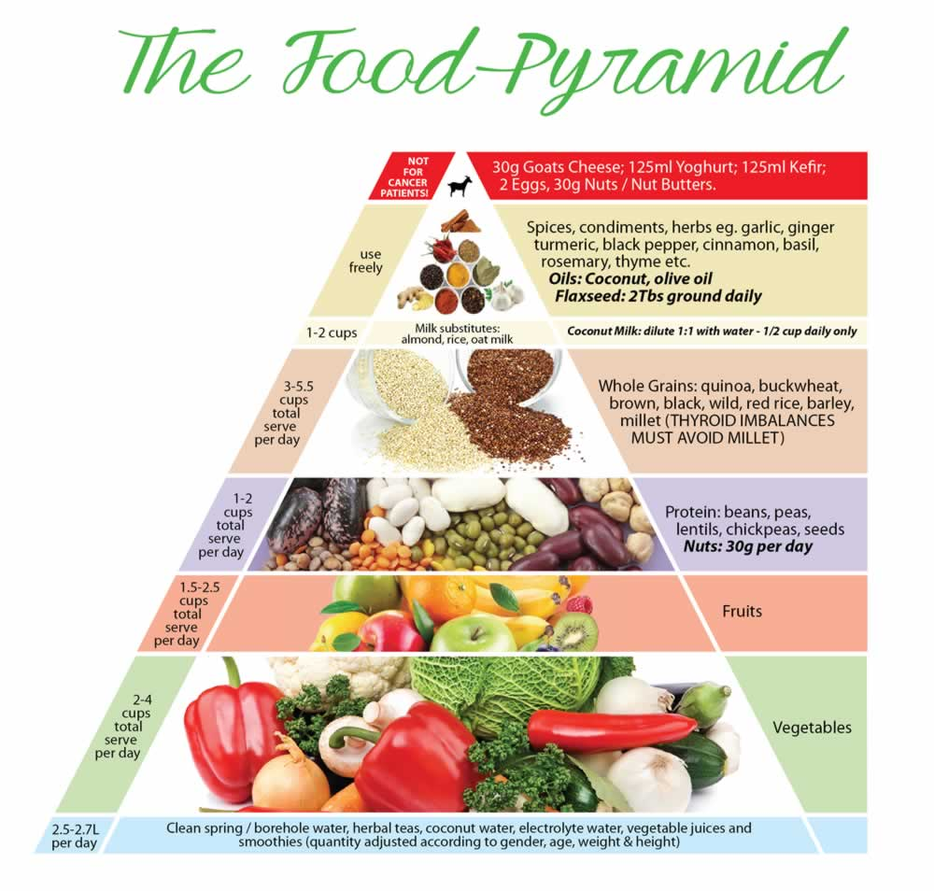
Ancient wisdom

Slide 43
Mindfull eating-Upayoga samstha
Ayurveda emphasizes freshly cooked food consumed within half hour of cooking, as stale food loses its prana (life force)
Eat warm food as cold food reduces Agni and the power of digestion
Eat the right quantity of food. This should be decided by the person based on body type, levels of activity. It is recommended to fill our stomach half with food , one quarter with water and one quarter with air.
Notes:
Ayurveda emphasizes freshly cooked food consumed within half hour of cooking, as stale food looses its prana (life force)
Eat warm food as cold food reduces Agni and the power of digestion
Eat the right quantity of food. This should be decided by the person based on body type, levels of activity. It is recommended to fill our stomach half with food , one quarter with water and one quarter with air.
Giving full attention to the food you eat. It advises chewing the food thoroughly, eating at a moderate pace, enjoying the sight, smell, taste and texture of the food, stop eating when satisfied. Eating the right quantity of food is emphasized.
Eat only when hungry as hunger stimulates agni and digestive fire. Eating with out hunger can lead to indigestion and heavy feeling.
Ayurveda emphasizes a meal time routine when food is consumed in a regular time the body knows when to expect food and in anticipation it secreats digestive enzymes to support the physiological function of digestion.
Have a regular gap between meals three hours is recommended. Constantly and haphazardly snacking can lead to digestive imbalances.
It was recommended to eat in a peaceful surrounding . Food was considered an energy source so unsettled environment can enguf one in negative energy. In this situation one is likely to overeat, eat more quickly and then suffer from digestive issues.
If one is upset one should not eat. One should wait till emotions are calmed down . Ayurveda believes if food is consume with a tdisturbed mind it can be toxic to the body.
Always sit down to eat . Actually in Ancient times it was recommended to sit on the floor in padamasana pose to eat food. Food had to be honored a small prayer was commensed before consuming the food.
After the meal it was recommended to sit in vajraasana to help in digestion

Slide 44
Mindful eating
Give full attention to the food you eat.
Chew the food thoroughly
Eating at a moderate pace
Enjoy the sight, smell, taste and texture
Stop eating when satisfied
Eating the right quantity of food is emphasized.
Eat only when hungry as hunger stimulates agni and digestive fire.

Slide 45
Mindful eating
Ayurveda emphasizes a meal time routine when food is consumed in a regular time the body knows when to expect food and in anticipation it secretes digestive enzymes to support the physiological function of digestion.
There is a prescribed time for food

Slide 46
Mindful eating
Have a regular gap between meals three hours is recommended. Constantly and haphazardly snacking can lead to digestive imbalances.
It was recommended to eat in a peaceful surrounding . Food was considered an energy source so unsettled environment can enguf one in negative energy.

Slide 47
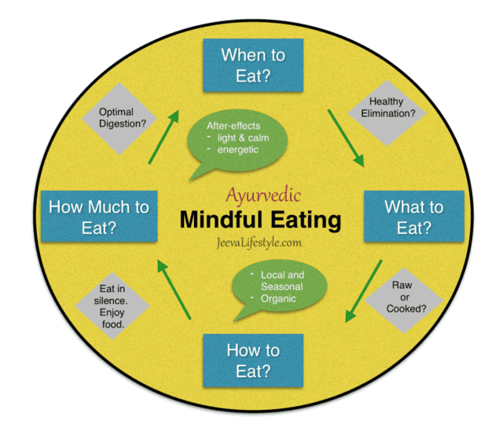

Slide 48
Mindful eating
If one is upset one should not eat. One should wait till emotions are calmed down .
Always sit down to eat . Actually in Ancient times it was recommended to sit on the floor in padamasana pose to eat food. Food had to be honored a small prayer was commenced before consuming the food.
After the meal it was recommended to sit in vajraasana to help in digestion

Slide 49
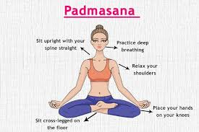

Slide 50
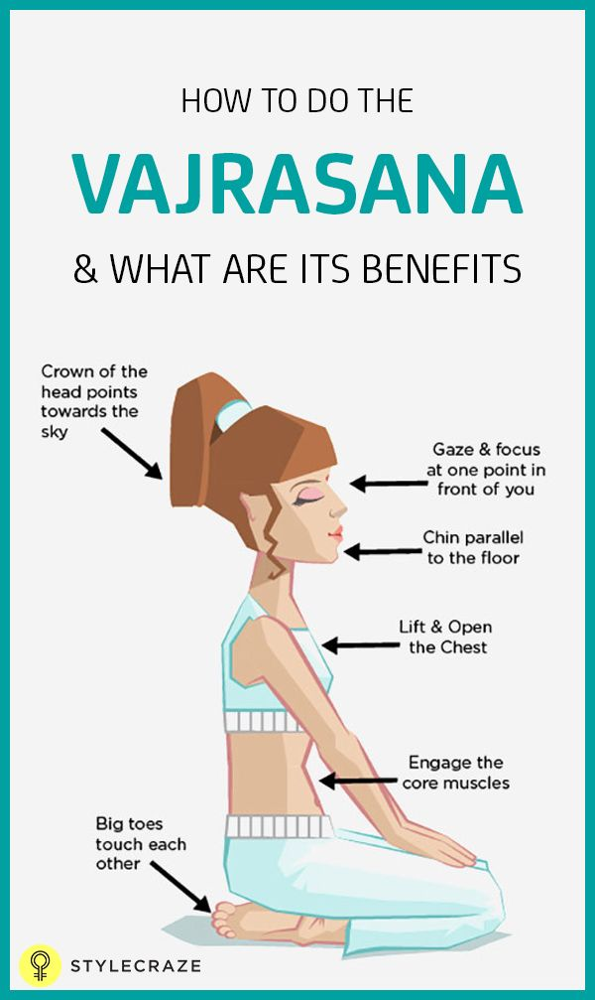

Slide 51
The General 7 Ancient wisdom Rules for today’s Food
Ancient Wisdom Rule 1
Eat Whole food plant based meals, try to eat local seasonal and clean organic.
Ancient Wisdom Rule 2
Sack Sugar, Wheat and Soy and their aliases.
Ancient Wisdom Rule 3
Eliminate the obesogens and their aliases: MSG,BPA, Phthalates and other Toxins- like Oxalates, Tannins, Phosphoric acid, reduce caffeine and Alcohol (no more than 2 servings per day).

Slide 52
The General 7 Ancient wisdom Rules for today’s Food
Ancient Wisdom Rule 4
Supplement with probiotics
Ancient Wisdom Rule 5
Supplement diet with micronutrients customized to
your needs
Ancient Wisdom Rule 6
Incorporate Herbal supplements customized to
needs

Slide 53
The General 7 Ancient wisdom Rules for today’s Food
Ancient Wisdom Rule 7
Practice mindful eating as recommended by Ayurveda

Slide 54
Personalized Action Plan
Personalized Nutrition
Genomic nutrition based on your neutrogenomic profile
Gut Microbiome testing – Personalized probiotics and diets
Ayurvedic nutrition according to body type; Khapha, Pita, Vata

Slide 55
Health Outcomes
Outline the outcomes you would like to achieve. Preferably write them down in a journal and tabulate them over a period of time.
The outcomes could be objective (those that can be measured) like
Weight
Body measurements
Blood pressure
Lipid profile
Heart health
Blood sugar
Fasting A1C

Slide 56
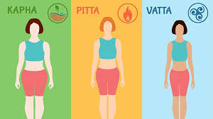
Ayurvedic body types

Slide 57
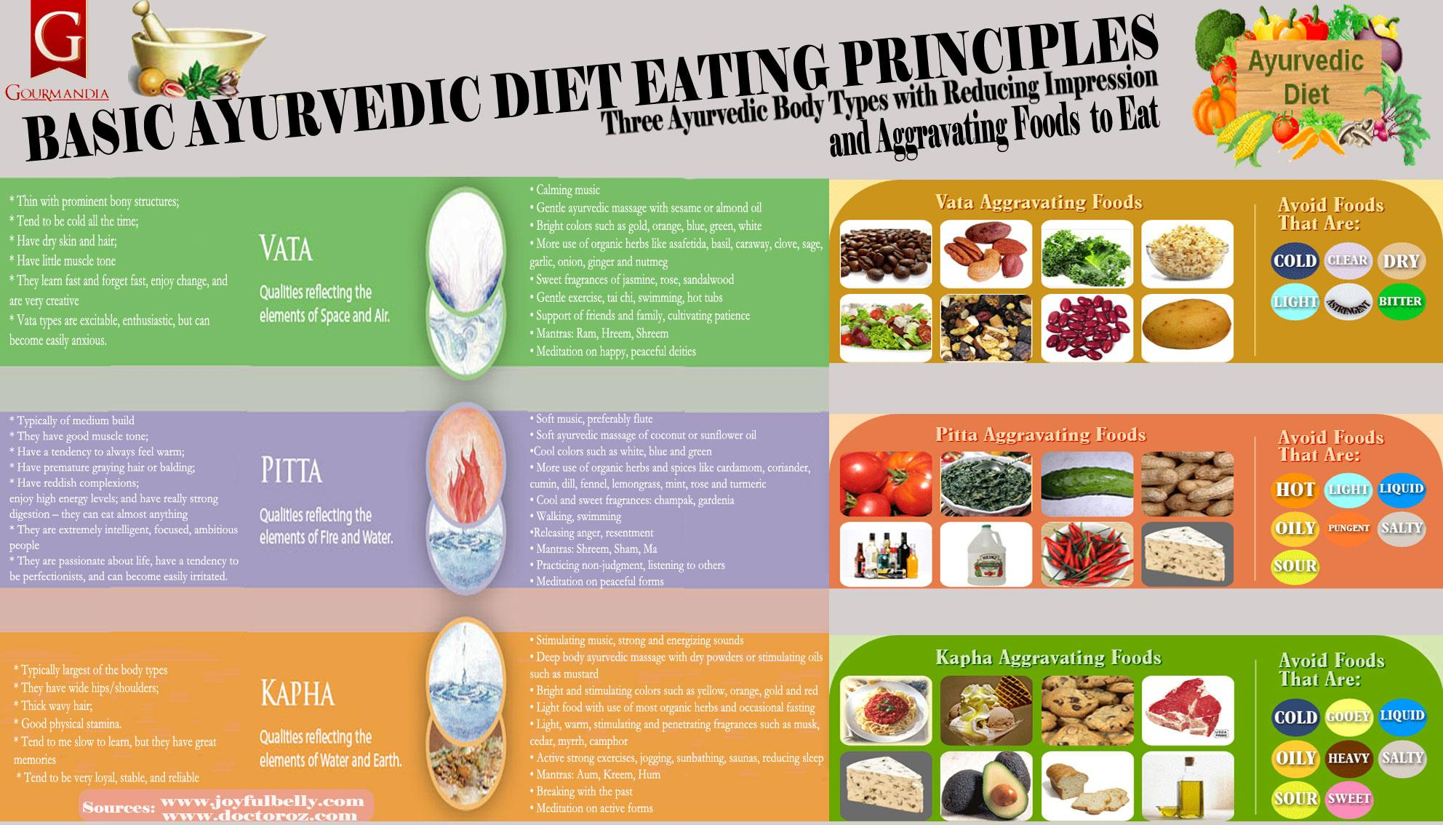

Slide 58
All lab works
Physical fitness
Bone health
Some subjective outcomes are ones that cannot be measured but are important for you.i.e
Mood and happiness
Energy levels
Activity levels
Feeling of well being etc

Slide 59
Food alone is not enough
Exerscise
Sleep
Emotional management
Relationships
Enviornment

Slide 60
Thank you

Slide 61
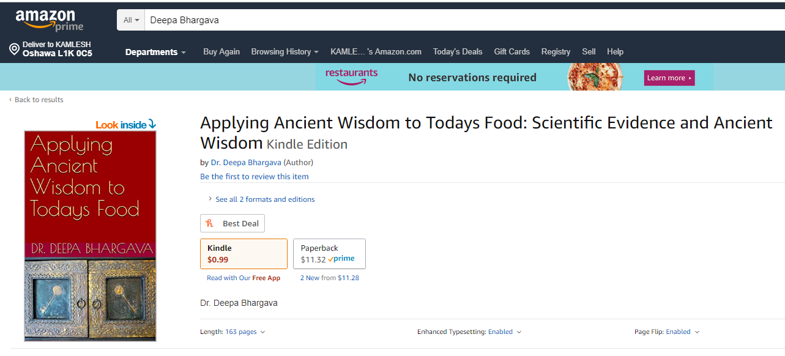
Free Book Download
21 - 25 February

