Slide 1
Shifting Our Focus Back to Prevention and Wellness
Dr. Wang Xi
PACE talks – March 16, 2022

Slide 2
Presenter Disclosures
Relationships with financial interests:
None
Potential for conflict(s) of interest:
None

Slide 3
Objectives
Discuss preventative health measures
That require your doctor or nurse practitioner
That you can do yourself (including if you do not have a family doctor)
Screening
Lifestyle measures
Getting comfortable with that more is not always better, and in some circumstances, doing more is worse!
Notes:
Chronic illness like HTN, diabetes – see your doctor

Slide 4
In the media

Slide 5
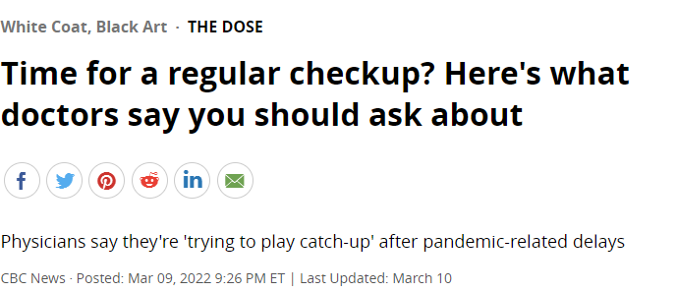
In the media

Slide 6
Disease screening in average risk individuals
What is screening?
Detection of disease in an early stage prior to symptom onset
Sometimes not a definitive test – a positive test requires confirmation
Effective screening is where early detection makes a difference in treatment and outcome
Cancer screening
Metabolic disease screening
Vascular disease screening
Infectious disease screening
Talk to your doctor or nurse practitioner!
Notes:
Get a piece of paper to record whether you are due for these tests

Slide 7
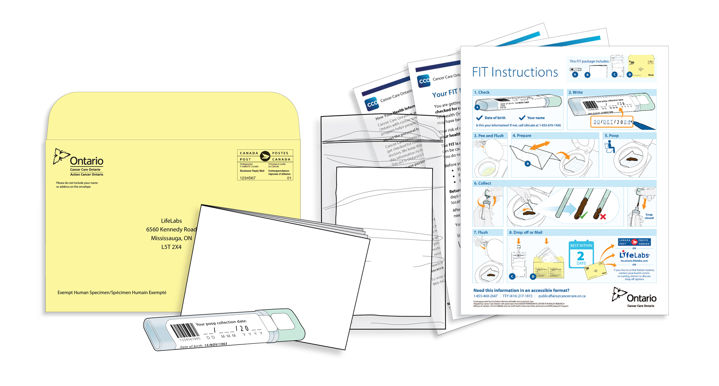
Colon cancer screening in average risk individuals
Age: 50 to 74
Every 2 years
Test: Fecal immunohistochemistry test
Can be obtained with Telehealth Ontario at 1-866-828-9213

Slide 8
Breast cancer screening in average risk individuals
Age: 50 to 74 women
Every 2 years
Test: Mammogram
Call 1-800-668-9304 to find the screening centre near you, or call NHH screening centre (905) 377-7795, or Port Hope Bluewater Imaging screening centre (905) 885-9839

Slide 9
Cervical cancer screening in average risk individuals
Age: 21 to 69 women
Every 3 years
Test: Pap smear
Notes:
Can be done during menstrual cycle

Slide 10
Lung cancer screening
Age: 55 to 74
Criteria
>= 30 pack-year history (e.g. smoked 1 pack per year for 30 years)
Currently smoking or quit less than 15 years ago
Test: CT scan of the chest yearly for 3 years
Notes:
Criteria in Ontario during test pilot was smoked everyday for 20 years (non-consecutive OK)

Slide 11
Abdominal aortic aneurysm screening
Age: 65 to 80 men
Test: ultrasound of the abdomen
Alternative screening criteria is age 65 to 75 men who have ever smoked; age >60 men who have a sibling or parent with an abdominal aortic aneurysm

Slide 12
Osteoporosis screening
Age: 65+
Every 1-5 years, depending on risk level of first BMD
Test: Bone mineral density
Talk to your doctor for screening at < 65 years old if you have risk factors such as a fracture from falling from standing, long-term steroid use, or weigh less than 60 kg (132 lbs)

Slide 13
Routine blood work
Age: 40+
Can be done every 3-5 years for average risk individuals
Often done yearly for risk factors
Checks for
Diabetes
High cholesterol
It is reasonable to have a one-time screen for hepatitis C for age 18+

Slide 14
Vaccinations
Tetanus: every 10 years
Pneumonia: Prevnar at age 65, followed 8 weeks later by Pneumovax
Shingles: Shingrix at age 50+, covered by OHIP at ages 65-70
Flu: yearly
Human Papilloma Virus: up to age 45
Vaccinations prior to travel

Slide 15
What don’t we (or only sometimes) screen in average risk individuals
Prostate cancer in men
Thyroid disease
Cognitive impairment

Slide 16
What about the annual physical?
“We recommend that primary care practitioners adopt periodic preventive health visits instead of providing annual physical examinations for the delivery of preventive services.”
Every 1-2 years
Blood pressure
At home, average BP ≤ 135/85

Slide 17
How to measure your blood pressure at home
Don’t exercise, smoke, or drink/eat for 30 minutes prior
Wear a short-sleeve shirt that you can roll up
Sit upright on a dining chair in a quiet space with your legs uncrossed and feet flat
Wait 5 minutes
Support your arm on a table
Measure your blood pressure 3 times, 1 minute apart
Drop the first reading, and average the last 2 to get your BP for that sitting
Repeat the process twice a day for a week
Average all the readings for a target of ≤ 135/85

Slide 18
Lifestyle modifications for preventative health
Smoking cessation
Mediterranean diet
Physical activity
Following low-risk alcohol intake guidelines

Slide 19
Smoking cessation
40-50% risk reduction in cardiovascular disease
Cardiovascular risk is reversed after 5-10 years of smoking cessation
It is a very difficult task
Long-term quit rate: 8%
With medication
Nicotine patch: 1.6 times more likely to quit
Bupropion: 1.6 times more likely to quit
Varenicline: 2.2 times more likely to quit (up to 31% long-term quit rate)

Slide 20
Mediterranean diet

Slide 21
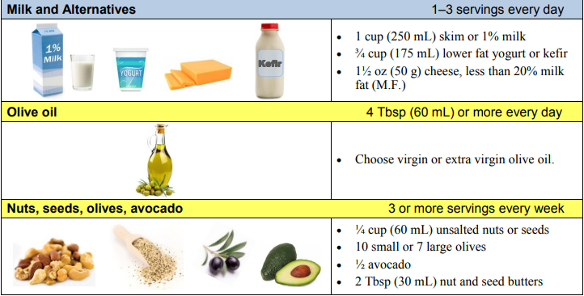
Mediterranean diet

Slide 22
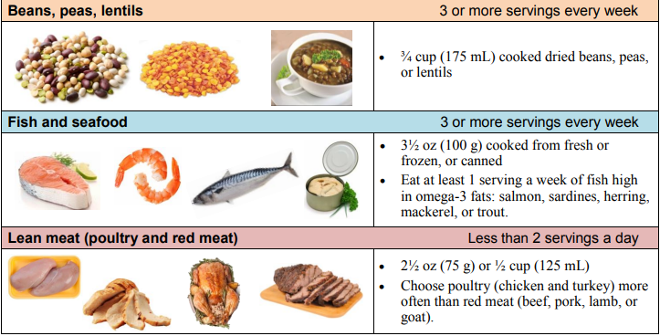
Mediterranean diet

Slide 24
Physical activity
150 minutes each week, in minimum 10 minute bouts
Moderate intensity
Brisk walking
Water aerobics
Cycling

Slide 25
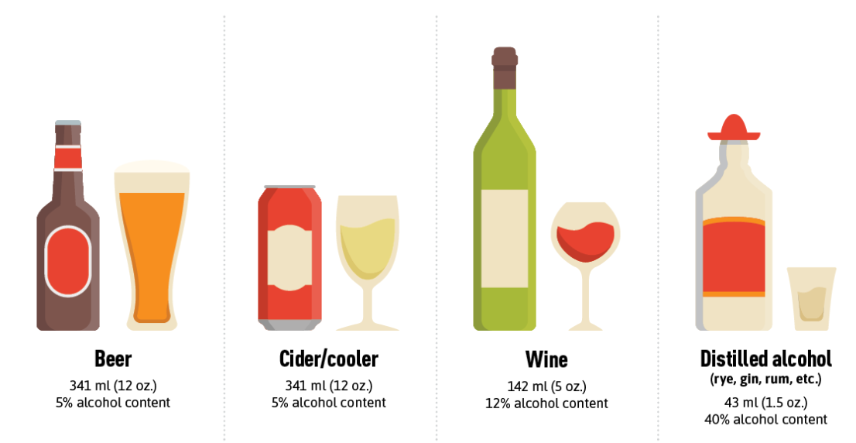
Following low-risk alcohol intake guidelines
Men: up to 15 drinks per week, up to 3 per day
Women: up to 10 drinks per week, up to 2 per day
Notes:
5.3 drinks in one 750 mL bottle of wine

Slide 26
How do we achieve these lifestyle modifications?

Slide 27
SMART goals
Specific
Measurable
Achievable
Relevant
Time bound

Slide 28
SMART goals
Non-specific goal: Get healthier
Specific: Exercise
Measurable: Walk for 30 minutes per day for 3 times per week
Achievable: Walk at 7PM after dinner on the treadmill on Tues, Thurs, Sat
Relevant: Helps reduce my cardiovascular risk by 25-35%
Time bound: Start April 1, re-assess May 1 to see if I am achieving my goal

Slide 29
What about weight loss?
Lifestyle interventions of smoking cessation, Mediterranean diet, physical activity, and following low-risk alcohol intake guidelines produce benefits in the absence of weight loss

Slide 30
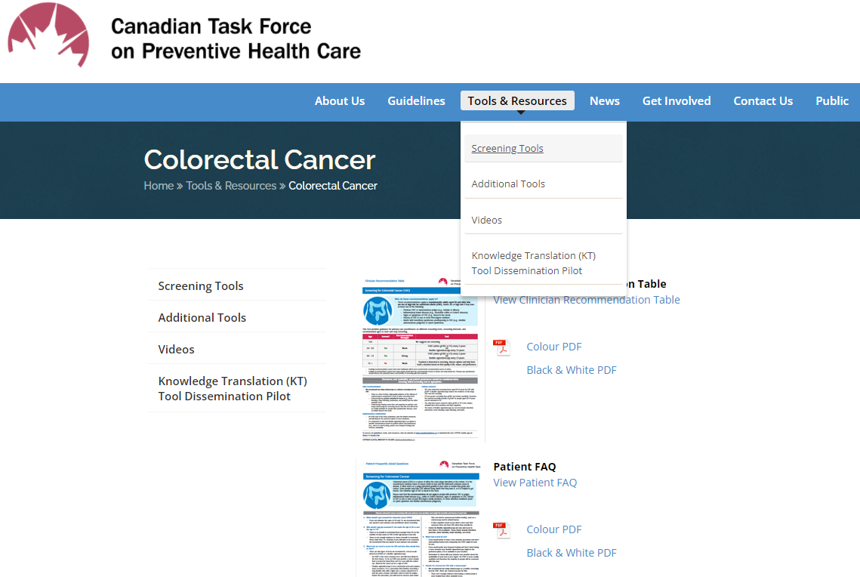
Resources
Preventative tests: https://canadiantaskforce.ca/

Slide 31
Resources
Mediterranean diet: https://www.albertahealthservices.ca/assets/info/nutrition/if-nfs-mediterranean-style-of-eating.pdf
Exercise: https://csepguidelines.ca/

Slide 32
Other important areas of wellness covered by previous PACE talks
December 2019: Don’t Be a Vector! How to Prevent Spreading Infections - and Getting Them, Dr. Dan Ricciuto
April 2021: Self-Care for Wellness, Dr. Anuja Sharma and Maureen Pollard
April 2019: The Science of Mindfulness, Dr. Jackie Gardner-Nix

Slide 33
Remember to visit your doctor for wellness advice tailored to you!

Slide 34
Thank you for your attention!

