Slide 1
The Good, the Bad and The Ugly: Finding Quality Health Information Online
Amanda Ross-White, MLIS, AHIP
March 20, 2019

Slide 2
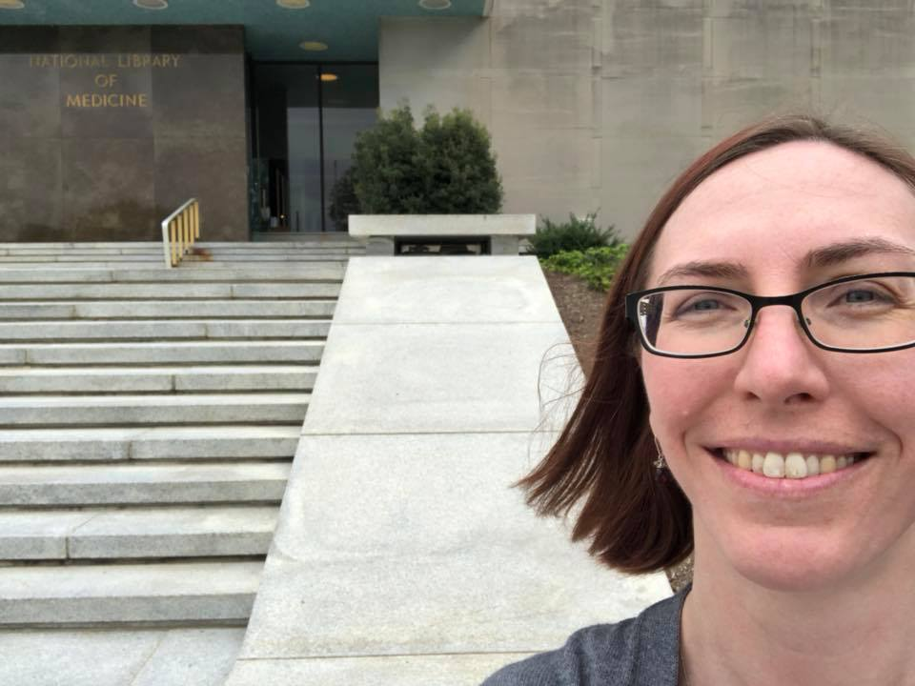
A little bit about me…
Librarian at Queen’s University since 2004
Previously at Brampton Public Library, Georgetown Public Library (Washington DC), and the Globe and Mail
Member of the Academy of Health Information Professionals

Slide 3
Paging Dr. Google
Over half of people visiting ER have Googled symptoms prior to coming to the ER
Over half of people visiting ER have Googled information about health care providers (eg. location of nearest hospital)
One quarter of people Googled information about treatment or management of an illness prior to visiting the ER
Asch JM, Asch DA, Klinger EV, et al. Google search histories of patients presenting to an emergency department: an observational study. BMJ Open 2019;9:e024791. doi: 10.1136/bmjopen-2018-024791
Notes:
A recent study in Philadelphia asked patients waiting in the emergency room if they could look at their Google search histories and compare it with information from their electronic medical record (EMR). Researchers looked at what searches they had done in the 7 days leading up to their visit and found that 15% of all searches were health related.
56% of patients searched for symptoms,
53% for information about a hospital or health care provider
23% about the treatment or management of a disease.
A majority (53%) of people who used Google in the week leading up to their ED visit searched for content directly related to their chief complaint.

Slide 4
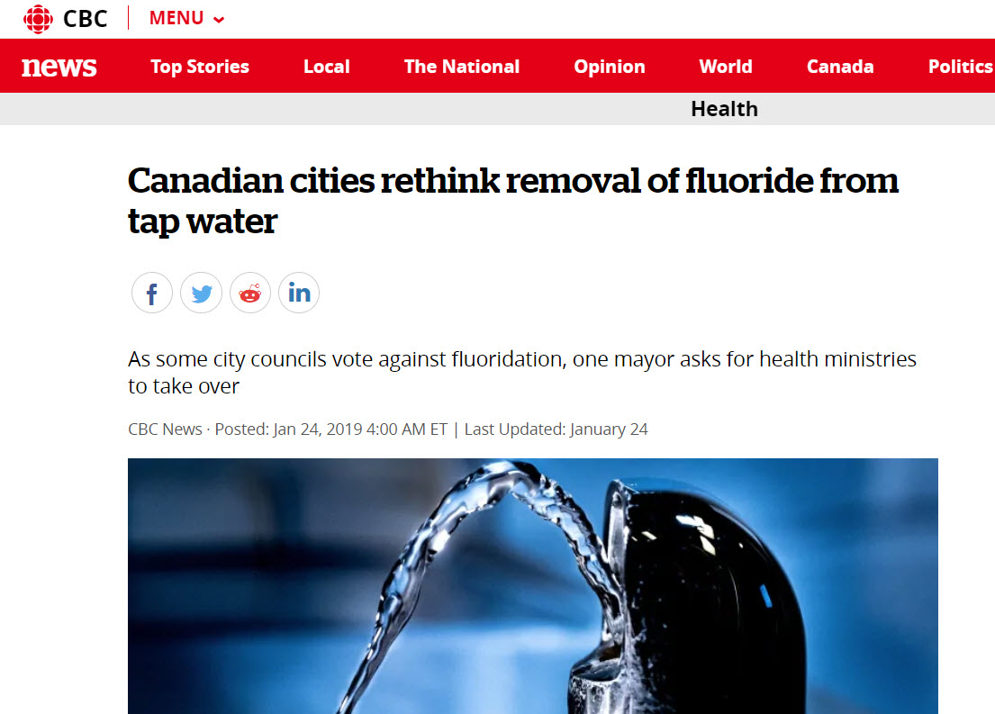
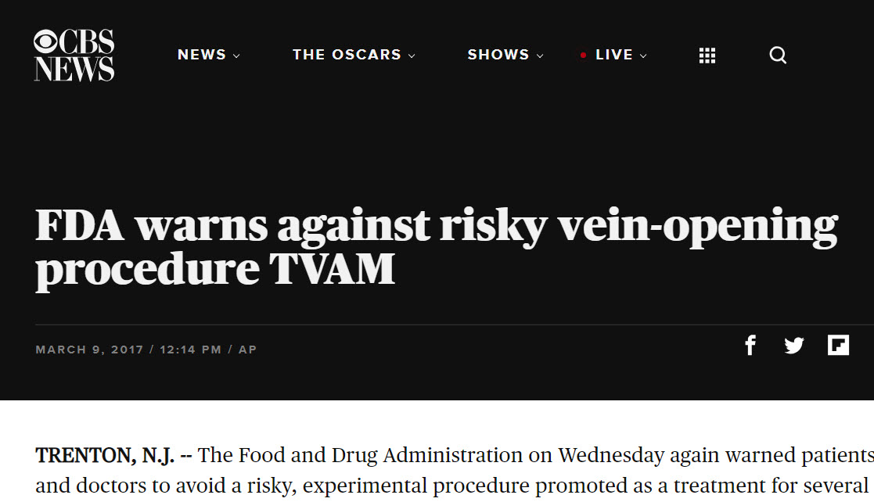
Misinformation is serious

Slide 5
But not all information is trustworthy!

Slide 6
IF I APPLY
Identify emotions
Find sources
Intellectual courage
Authority
Purpose/Point of view.
Publisher.
List of sources
Year of publication.
Personal
Source

Slide 7
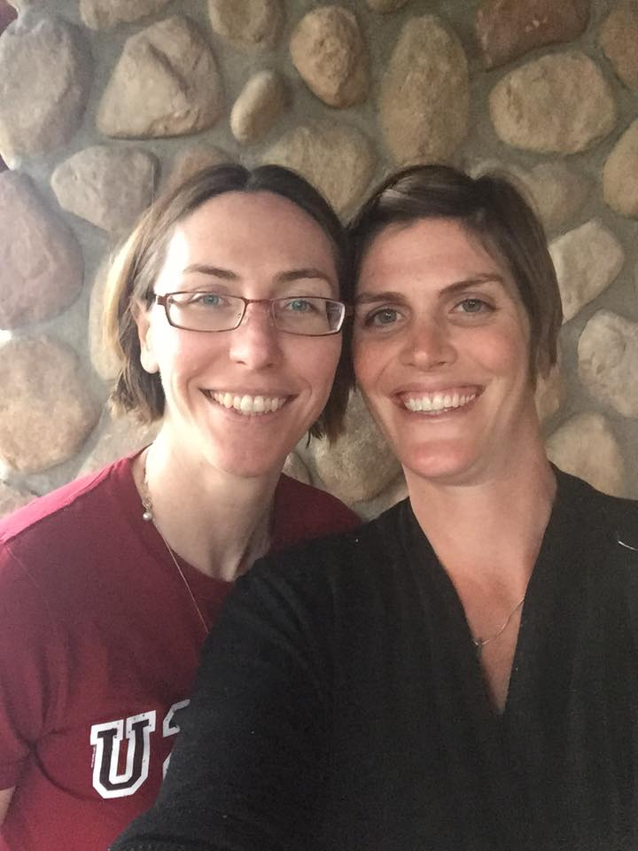
This is real life!
Notes:
Real world example:
“My sister has just been diagnosed with CML. I don’t know anything about it, but know it’s a type of cancer.”

Slide 8
I – identify emotions attached to a topic
What are your honest opinions about this topic?
We all have biases. What are your internal biases?
Notes:
My emotions:
Cancer is scary. Everything about it is scary. And this isn’t her first time with cancer!
Will she die? Will me, or other members of my family be at higher risk? Will she be able to keep working? What treatment will she need?
My bias is for science based medicine. I work in evidence based practice. I know people who work in cancer treatment: doctors, nurses, radiation therapists. I trust science.

Slide 9
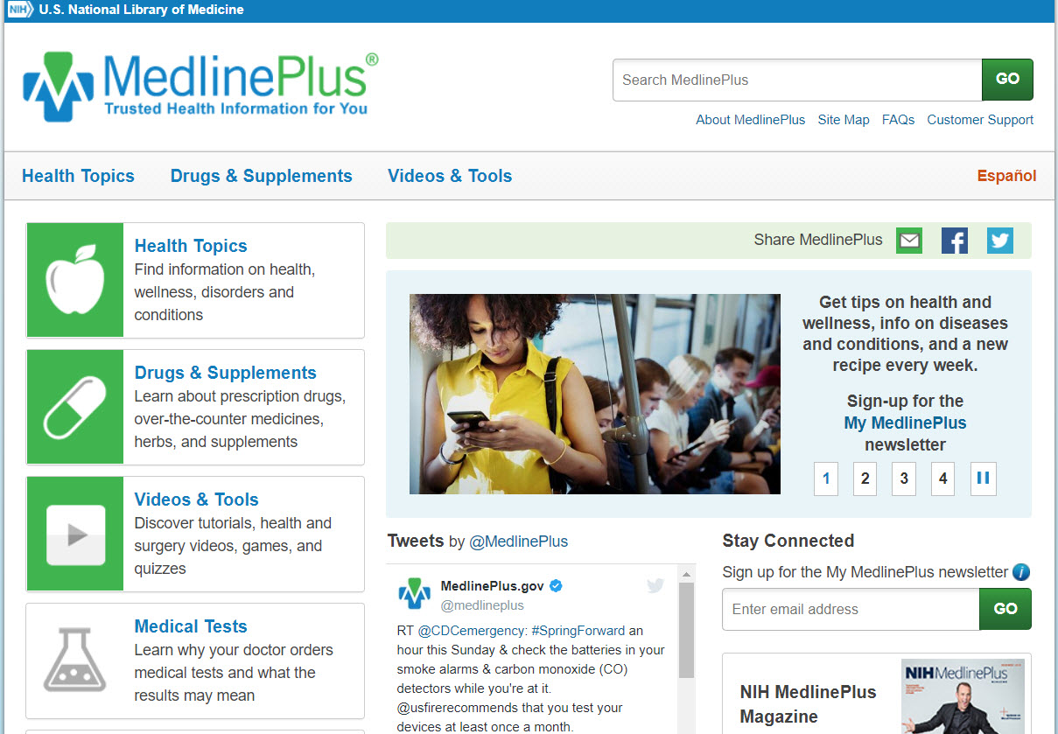
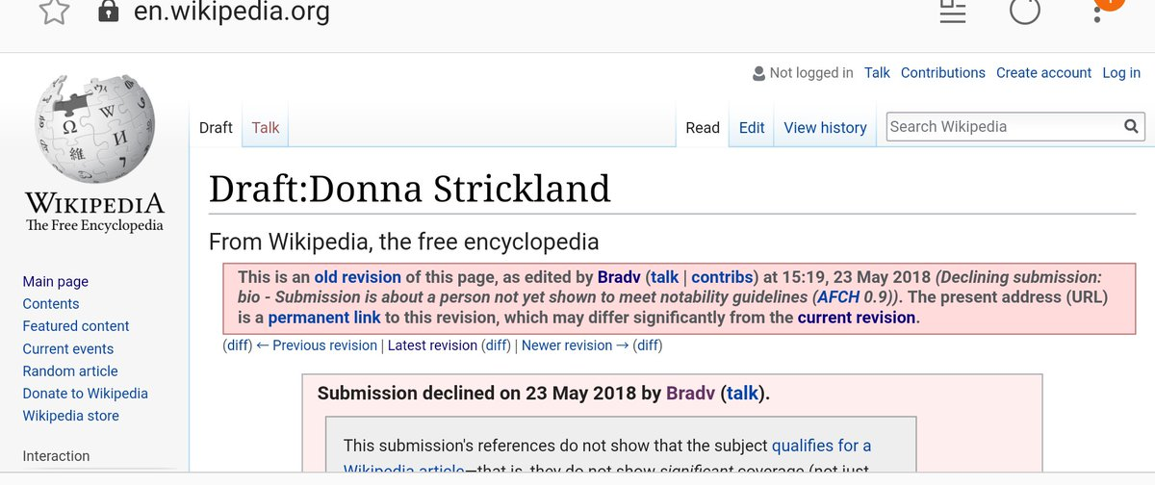
F - find unbiased reference sources
Looks for an informative overview of the topic
Search for information in: encyclopedias, wikis, dictionaries, etc.
Notes:
Show Wikipedia and MedlinePlus.gov
Is Wikipedia unbiased? Not really. Research shows that a vast majority of Wikipedia contributors are men, and that some voices are shut out. Just before she won the Nobel Prize, Dr. Donna Strickland had her Wikipedia entry deleted because she was “not a significant enough” physicist.

Slide 10
I - intellectual courage is needed
Seek authoritative voices on the topic that may fall outside your comfort zone
Identify credible materials for all of the viewpoints - yours and the additional you identified
Reject unsound arguments - have the courage to accept that not all viewpoints are valid
Notes:
Questions for the group – what is meant by authoritative voices? How do you know something is credible?

Slide 11
A – authority
Who is the author (may be individual or organization) and/or publisher?
What are the credentials and affiliation or sponsorship of any named individuals or organizations?
How objective, reliable, and authoritative are they?
Have they written other articles or books?
Do they specialize in publishing certain topics or fields?
Notes:
Canadian Cancer Society
No named author, but has a clear editorial policy that explains how their materials are written and evaluated for accuracy.
Involvement of many health care professionals in writing documents.
A lot of publications come from the Canadian Cancer Society, both web and print articles and books
Cancer is their specialty.
Natural News
Named author is Tara Paras. No clue who she is or what background she might have.
No credentials listed or editorial policy available
Links to many questionable news sites.
Not sure what the author has written beyond this website.
Not a cancer specialty site – mostly alternative health information, but lots of other strange unrelated stuff (eg. Justin Smollett links, etc. on left nav)

Slide 12
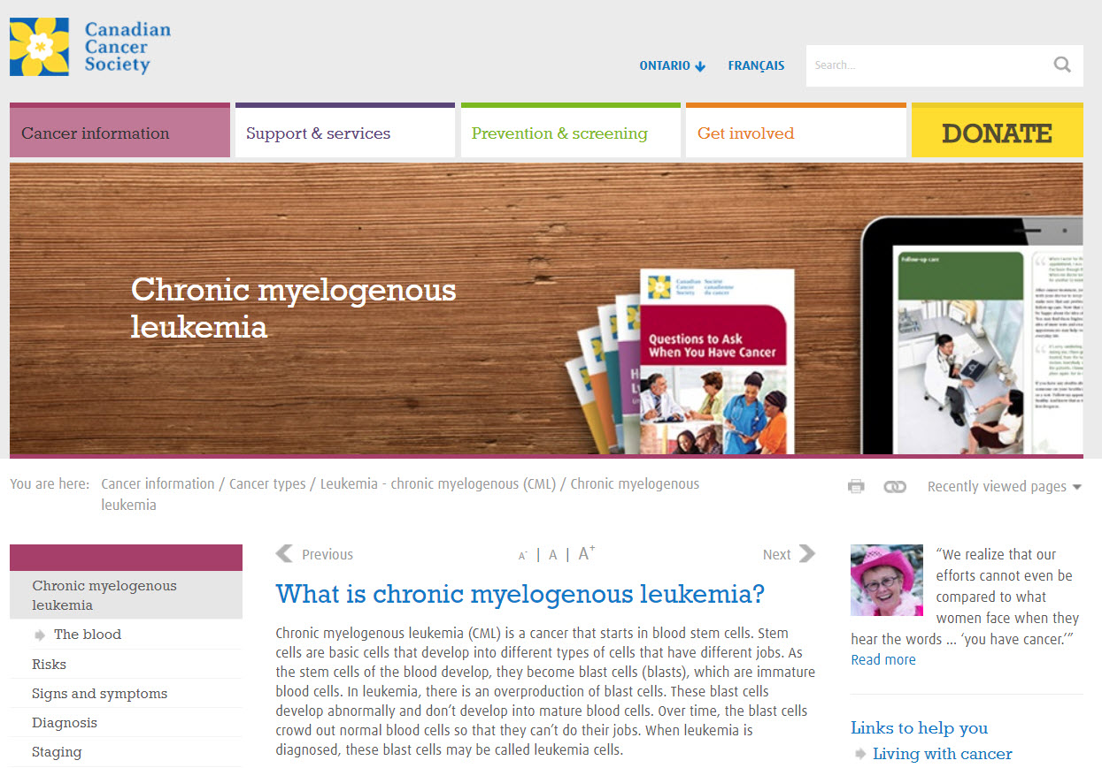

Slide 13
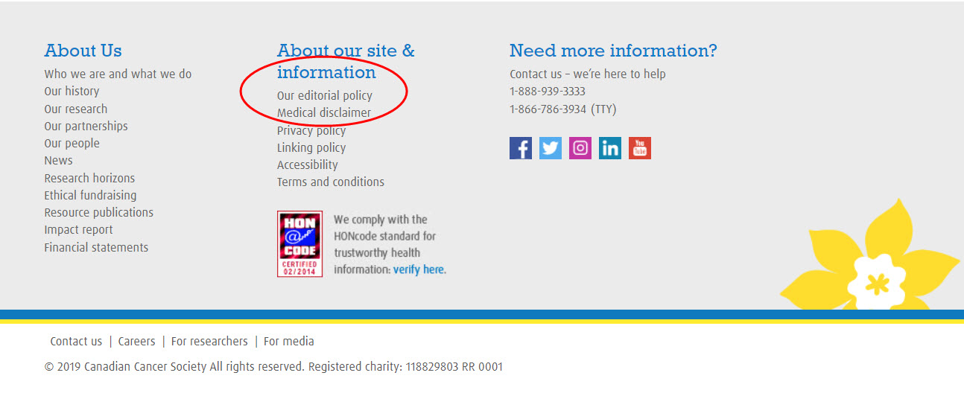

Slide 14
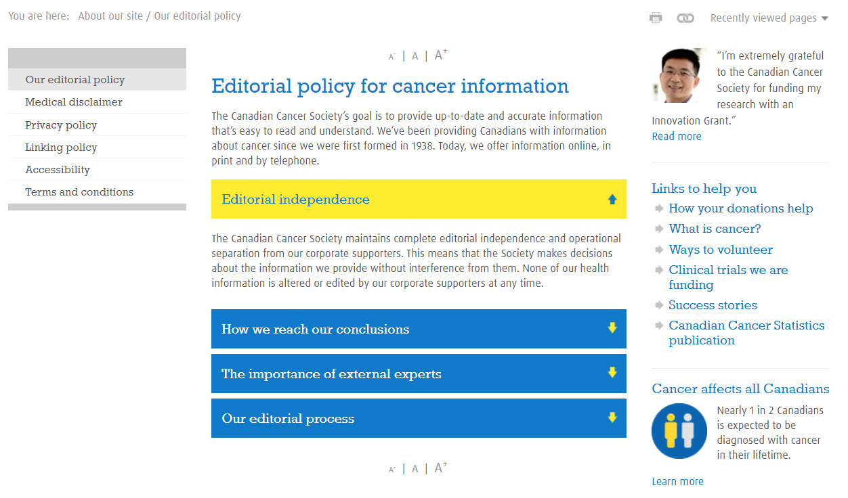

Slide 15
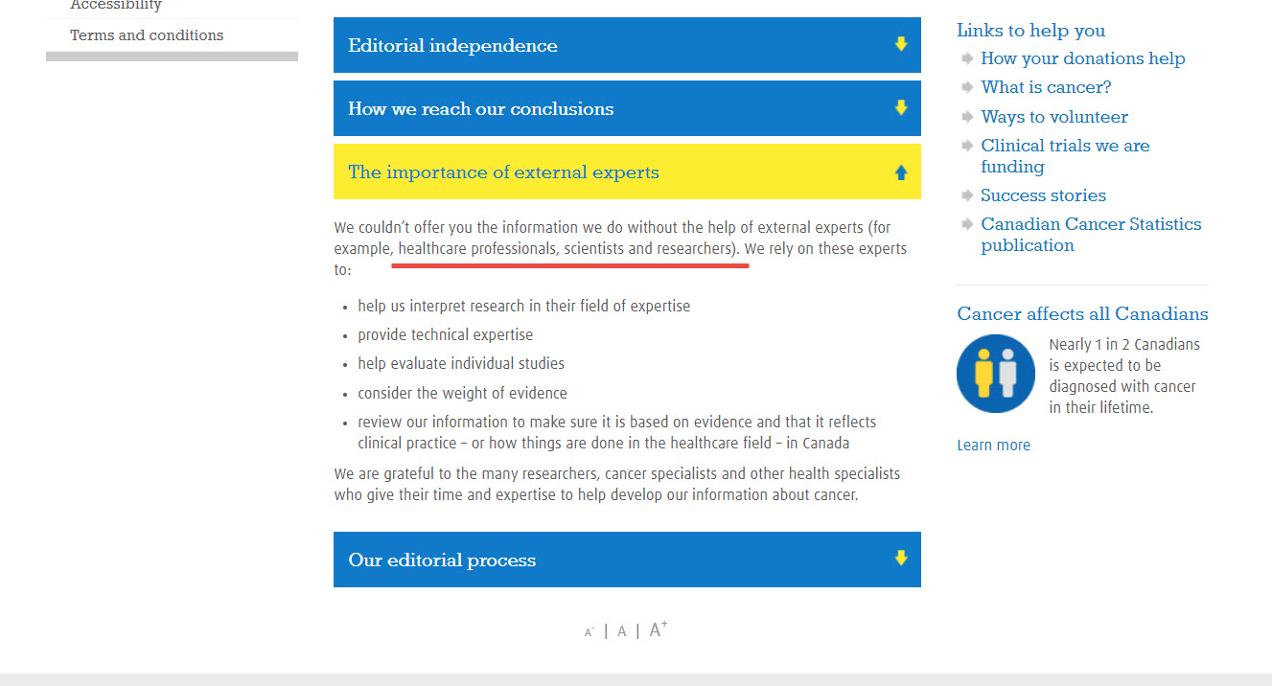

Slide 16
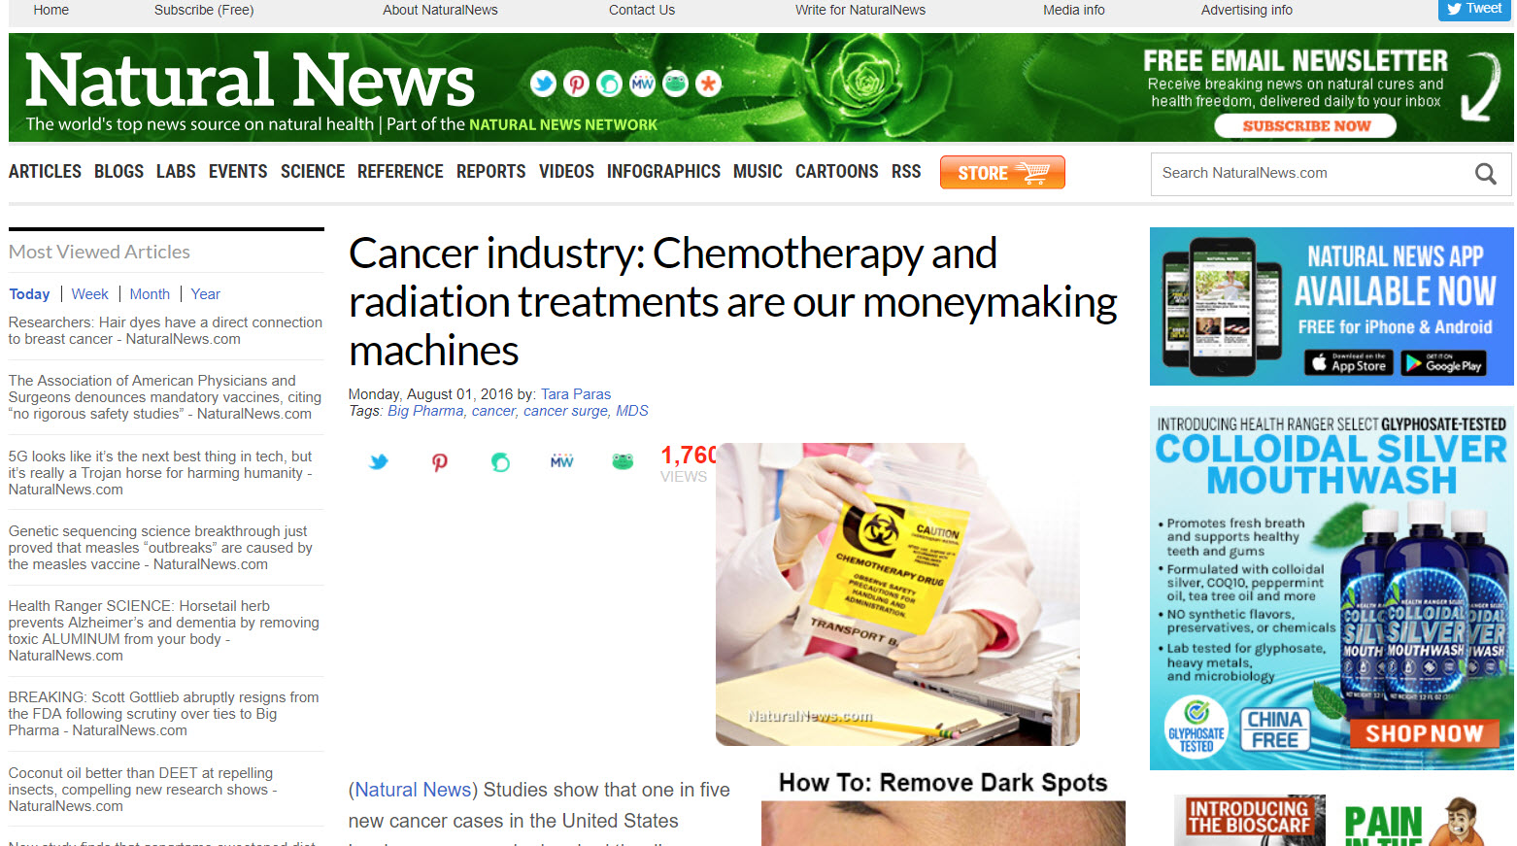

Slide 17
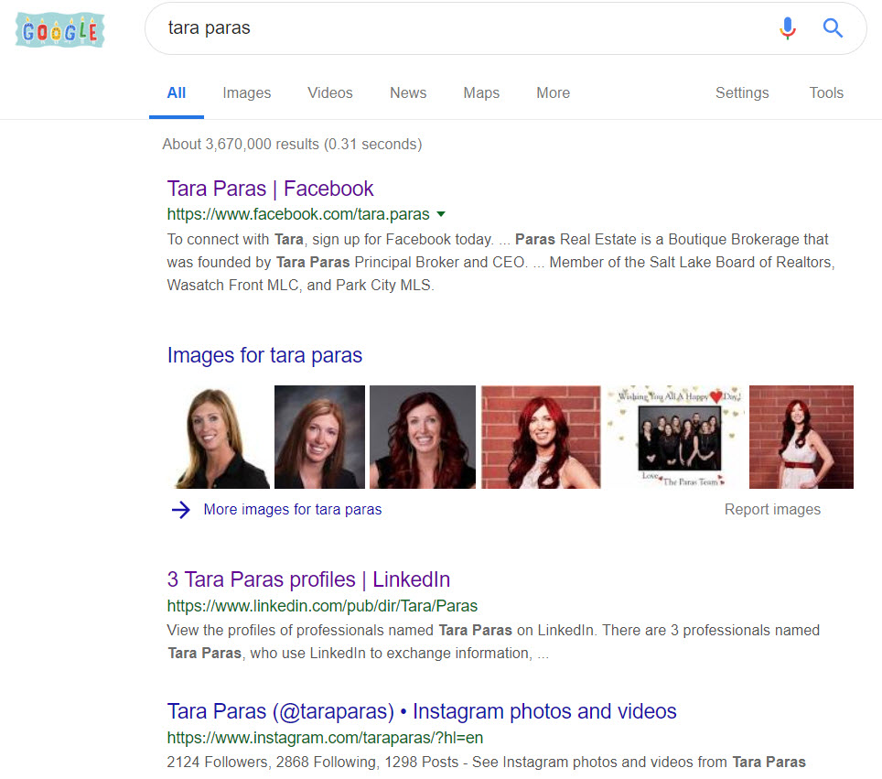

Slide 18
P – purpose/point of view of source
Does the author have an agenda beyond education or information?
What can be said about the content, context, style, structure, completeness and accuracy of the information provided by the source?
Are any conclusions offered? If so, based on what evidence and supported by what primary and secondary documentation?
Are diverse perspectives represented?
Is the content relevant to your information needs?
Why was the information provided by the source published?
What are the perspectives, opinions, assumptions and biases of whoever is responsible for this information?
Who is the intended audience?
Is anything being sold?
Notes:
Cancer Society
No agenda beyond education – not selling any products, no personal gain from treatment choices
Comprehensive, references are clearly available
Conclusions are backed by evidence and references are clear. Work with health care team to find individualized treatment options
Diverse perspectives not represented
Definitely relevant to my information needs. I found out that CML is not hereditary, so I am not at risk. My sister’s previous radiation therapy likely played a role.
Information about this illness is provided because giving Cancer Education is part of the Canadian Cancer Society’s mandate
Perspectives and opinions are not given. Information is factual and lacks inflammatory statements
Intended audience is people with cancer and their loved ones. Not cancer professionals.
Nothing is being sold. They are a not for profit. Donation button is prominent.
Natural News
Agenda appears to be to get people to reject cancer treatments. Pointed question at the end is accusatory
Conclusion is that some cancer is caused by previous cancer treatments, and so chemotherapy and radiation treatments should be avoided.
Diverse perspectives not represented. Author opinion only.
Not relevant to my needs – even if my sister’s CML was caused by radiation therapy for a brain tumour, she can’t go back in time to opt out now!
Not clear why the information was provided, but they sure sell a lot of alternative treatments…
Assumption that there is a conspiracy among pharmaceutical companies. Assumption that Western medicine has ‘feigned ignorance’ (is it not possible they truly, actually, honestly don’t always know what causes cancer?)
Audience is not people who’ve already been diagnosed, but the general population.
Lots of stuff being sold!

Slide 19
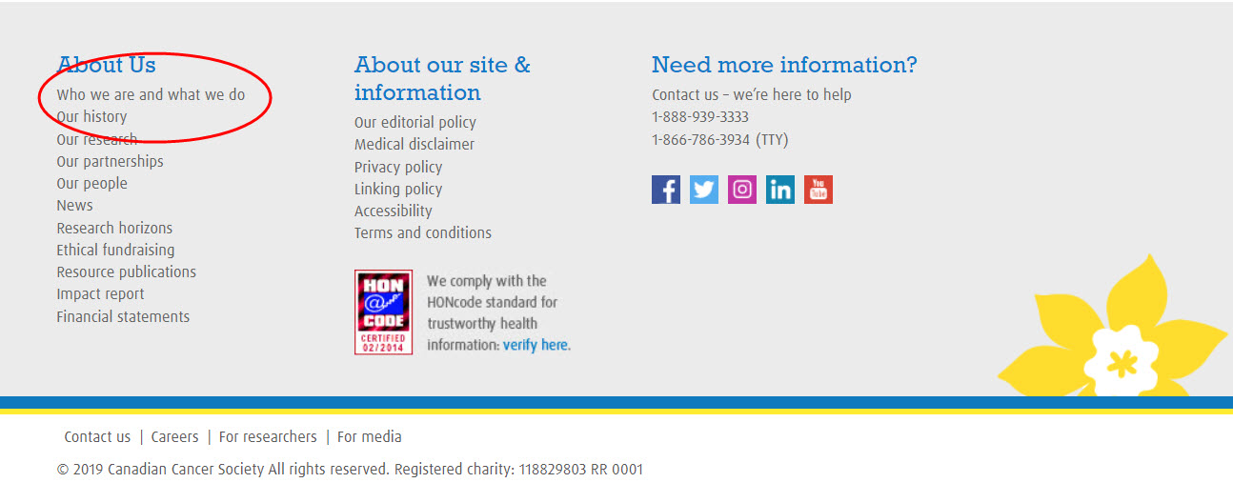

Slide 20
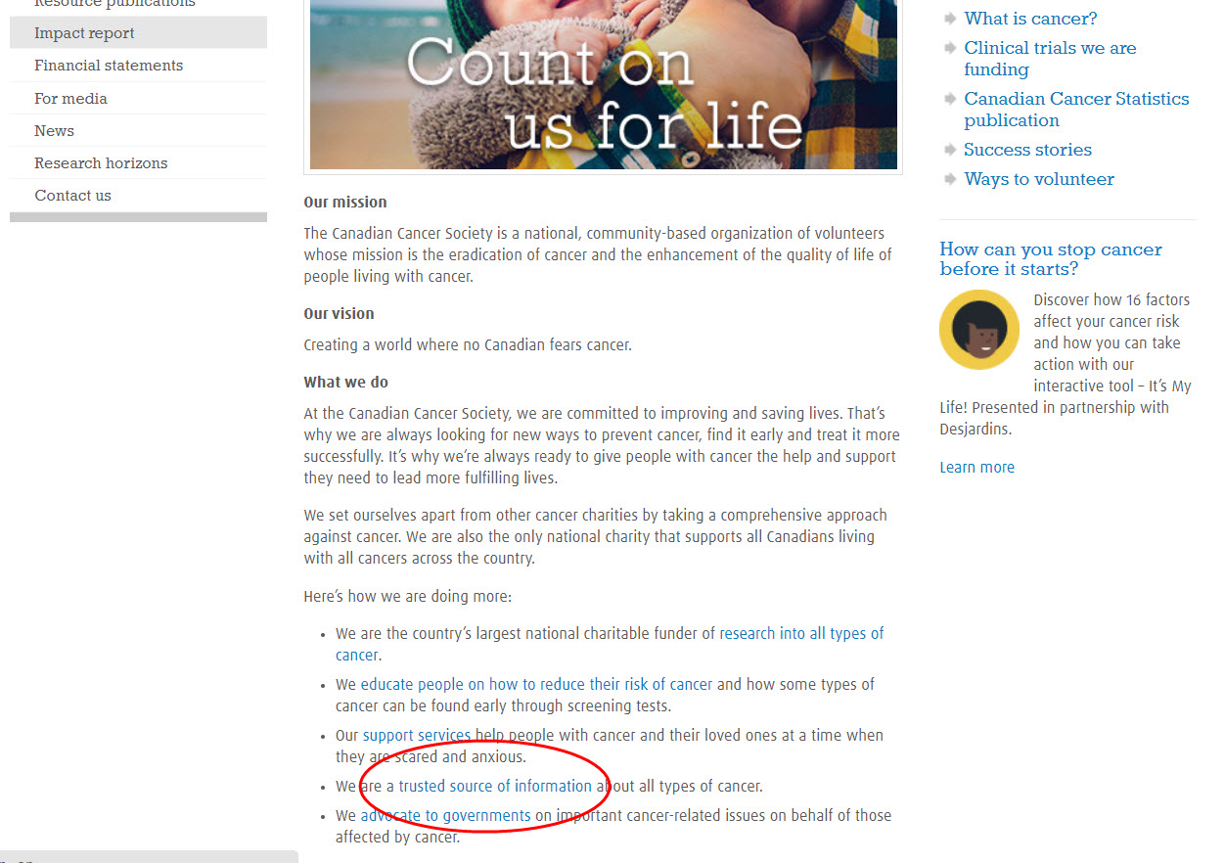

Slide 21
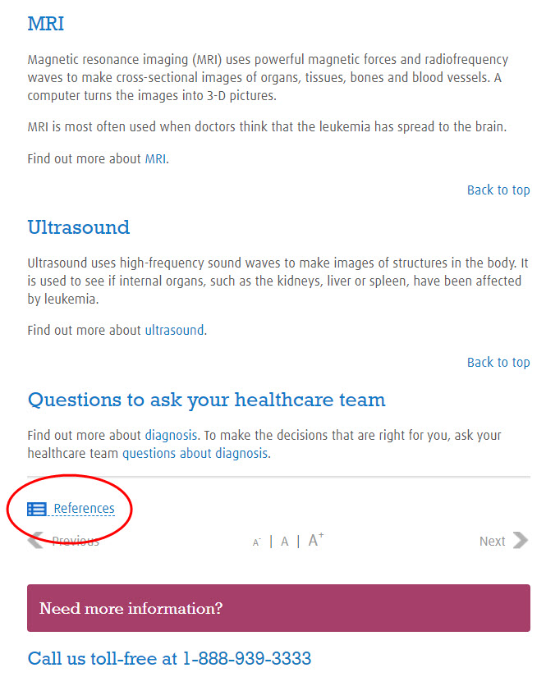
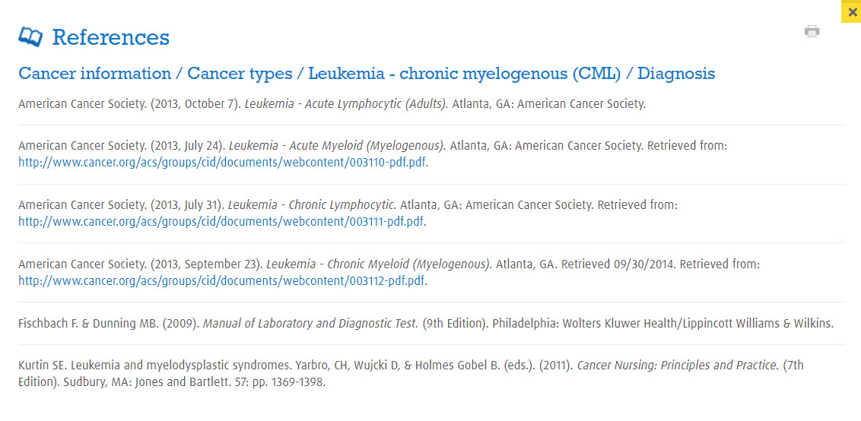

Slide 22
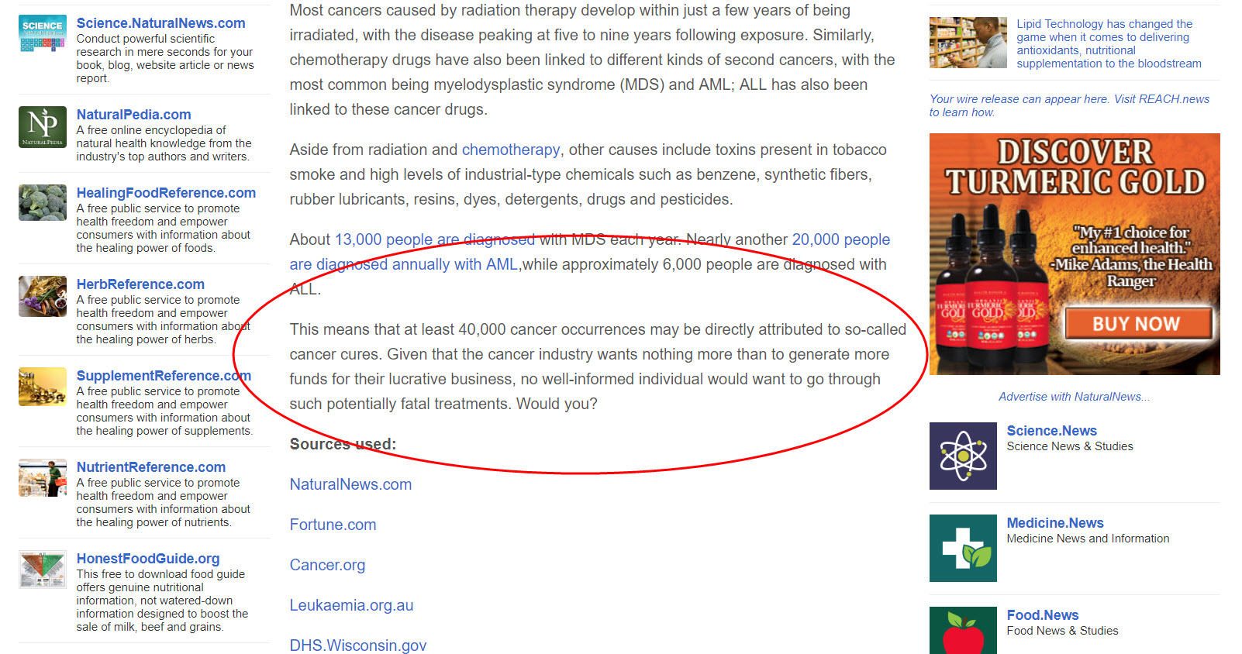

Slide 23
P – publisher
Does the publisher have an agenda?
When was the information published?
Is the information provided by the source in its original form or has it been revised to reflect changes in knowledge?
Has the publisher published other works?
Is this information timely and is it updated regularly?
Is the publisher scholarly (university press, scholarly associations)? Commercial? Government agency? Self (“vanity”) press?
Notes:
Canadian Cancer Society
Clear mission statement on web page is “mission is the eradication of cancer and the enhancement of the quality of life of people living with cancer.”
Not clear when the information was published.
Not clear when it was last updated.
Yes, many publications by the author.
Not clear. It appears to be (references are current)
Publisher is a respected not-for-profit.
Natural News
About us page clearly states “The site strongly criticizes drugs-and-surgery medicine, vaccines, corporate corruption, animal testing, the use of humans for medical experiments, the chemical contamination of foods, heavy metals in consumer products, factory farming and government corruption.”
Byline date of August 2016
No updates appear to have been done, but it is still recent information
Many similar articles and websites about government ‘cover ups’ and other conspiracy theories
The about us webpage suggests the site is closely controlled by a single individual calling himself Mike Adams, the Health Ranger. He claims to be an ‘activist-turned-scientist’ but does not say what area of science he has studied or where he earned his degrees.

Slide 25
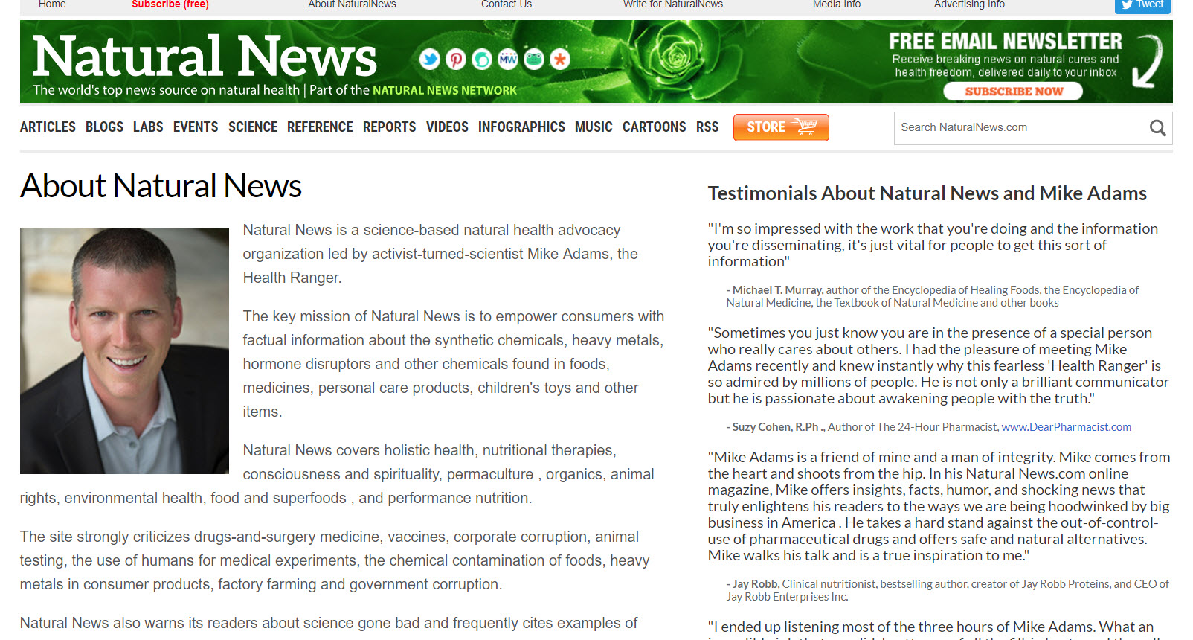

Slide 27
L – list of resources
Where else can the information provided by the source be found?
Is this information authentic?
Is this information unique or has it been copied?
Notes:
Canadian Cancer Society
Comparing the information found on the American Cancer Society website, Medlineplus.gov, or the NHS web site is very similar. Many major cancer organizations have reached a consensus here.
Information appears to be authentic and statistics are backed by solid, recent references.
Information does not appear to have been copied, but it isn’t unique either. Similar information found on other sites.
Natural News
Some statements are not verified (eg. Cancer has increased “300 percent since the 1970s”). Even if this were true, no explanation about the difference between relative and absolute risk.
Some statements link to questionable sources, not reputable ones.
Many statements not verified or unverifiable. (eg. “the cancer industry wants nothing more than to generate more funds for their lucrative business”). Can you tell what’s inside someone else’s mind? What evidence is there that cancer industry wants to generate funding?
Information is not completely unique, but it doesn’t agree with the vast majority of cancer charities or government organizations.

Slide 30
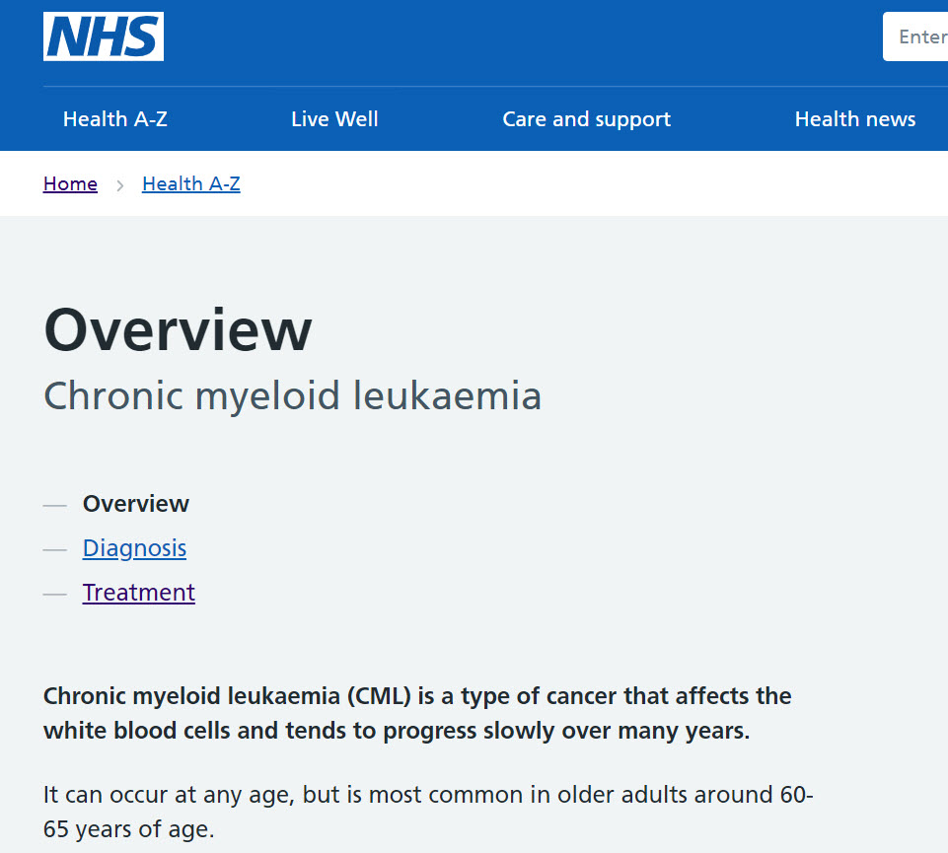

Slide 31
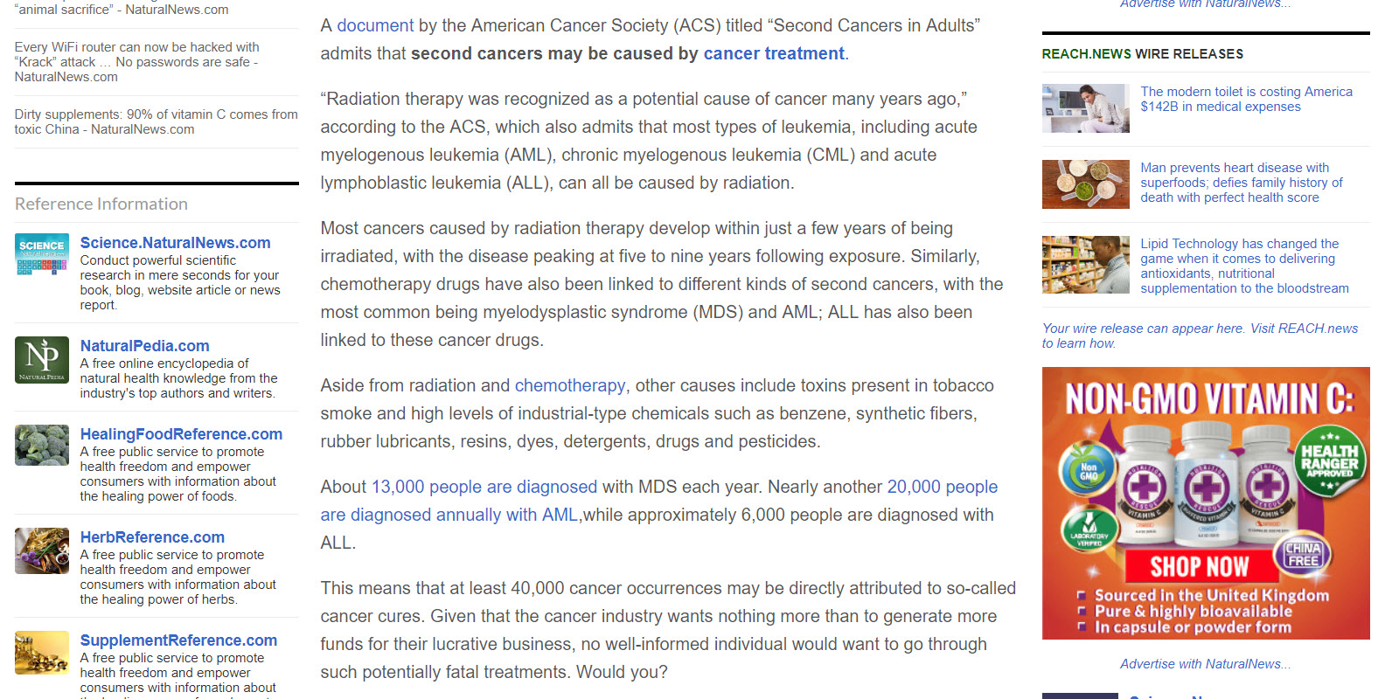

Slide 32
Y – year of publication
What makes information “current” or relevant?
Is this information current? Can you find more current or relevant information?
Is the cited information current? Make sure work is not based on outdated research, statistics, data, etc.
Is the information routinely updated?
Notes:
Canadian Cancer Society
Publication date not clear, but editorial policy indicates that print materials are reviewed at least once a year:
“Our cancer information pages are reviewed and updated regularly. And if the evidence changes, these pages are updated as soon as possible.
Print materials are reviewed every year before they are reprinted. All print materials include our toll-free phone number and email address so that people can contact us for the most up-to-date information.”
Statistics are from 2013 and indicate this is the most recent year available.
Natural News
Published in 2016.
Statistics are fairly recent
Information doesn’t appear to be regularly updated and instead is based on new ‘articles’ being published.

Slide 33
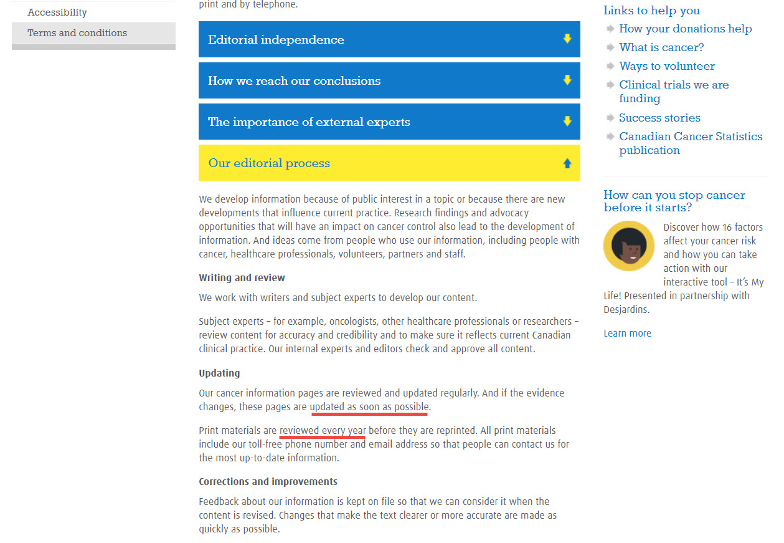

Slide 35
Handouts
Recommended Resources
IF I APPLY – questions to ask when evaluating information

