Slide 1
Caring for your skin.
Dr. Anuja Sharma

Slide 2
Learn about-
What does your skin do for you?
What is your skin type?
What is proven to be helpful?
What is known to be harmful?

Slide 3
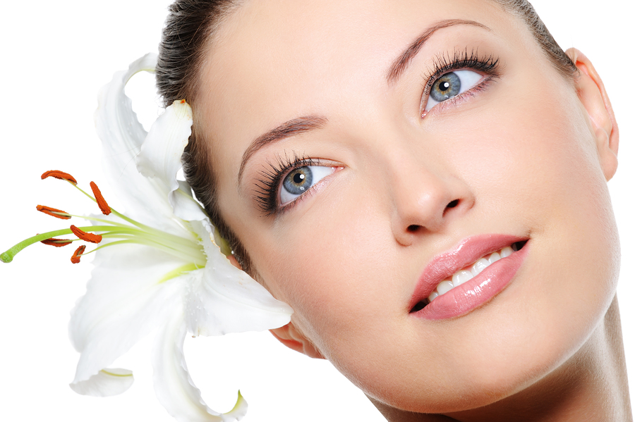
Skin.
This Photo by Unknown Author is licensed under CC BY-NC-ND

Slide 4
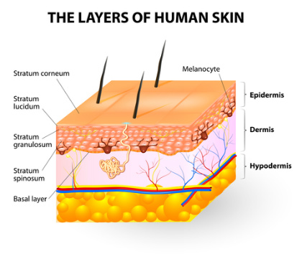
This Photo by Unknown Author is licensed under CC BY-NC

Slide 5
KNOW YOUR SKIN TYPE-
Dry or oily?
Sensitive or resistant?
Prone to discolouration?

Slide 6
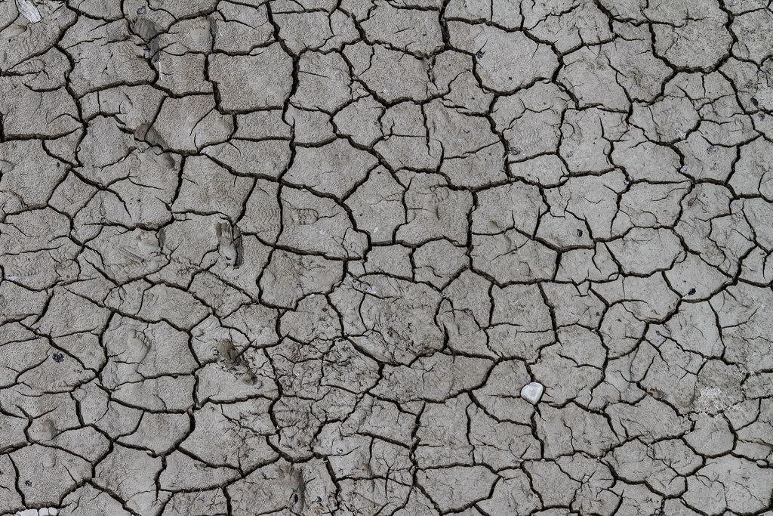
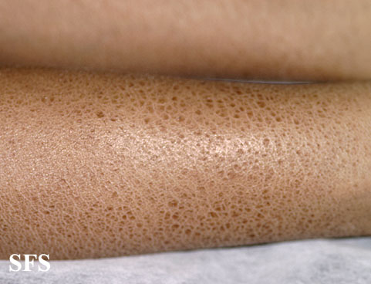
This Photo by Unknown Author is licensed under CC BY-SA
This Photo by Unknown Author is licensed under CC BY-NC-ND

Slide 7
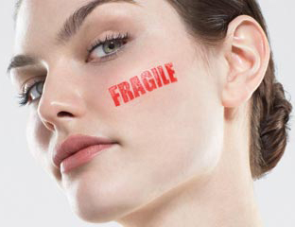
This Photo by Unknown Author is licensed under CC BY-NC

Slide 8
This Photo by Unknown Author is licensed under CC BY

Slide 9
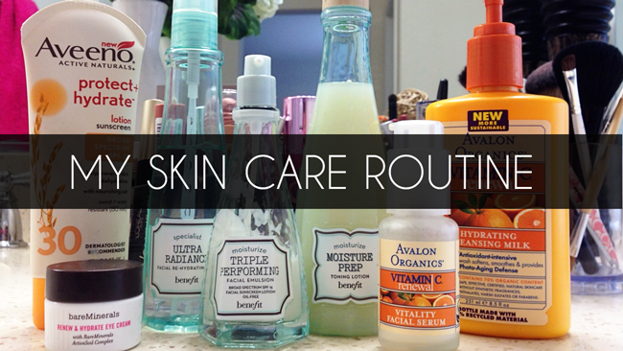
This Photo by Unknown Author is licensed under CC BY-SA-NC

Slide 10
Cleanse, moisturize and protect.
3 step formula.

Slide 11
How to choose?
Which brands?
What ingredients and concentration?
Is ‘Dermatologist approved’ on the label important?
Soap or body wash?
Sunscreens or sunblock?
Moisturizing creams or lotions?
Antioxidants

Slide 12
Cleanse
Fat plus lye is soap.
Liquid or bar soap?
Skip soaps with colors and fragrances.
Soap free cleansers for dry skin.
This Photo by Unknown Author is licensed under CC BY-SA

Slide 13
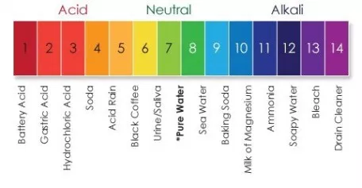

Slide 15
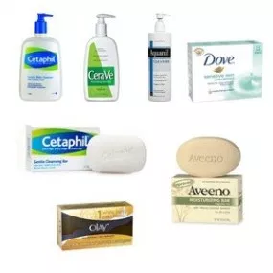

Slide 16
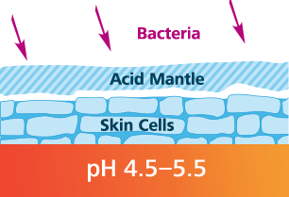

Slide 17
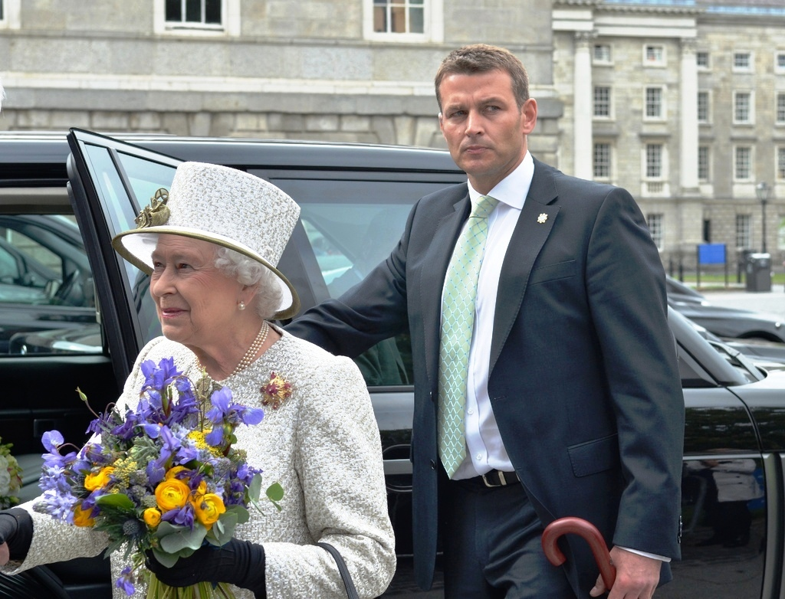
This Photo by Unknown Author is licensed under CC BY-SA

Slide 18
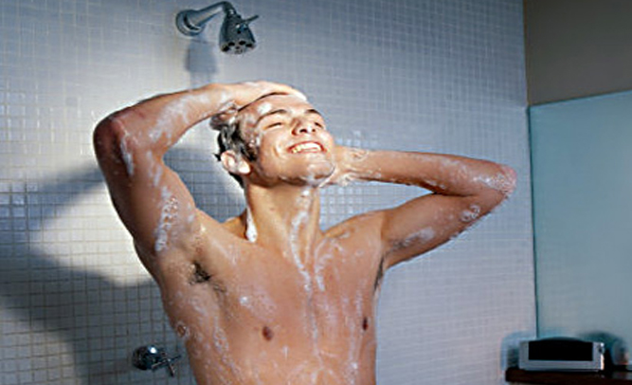

Slide 19
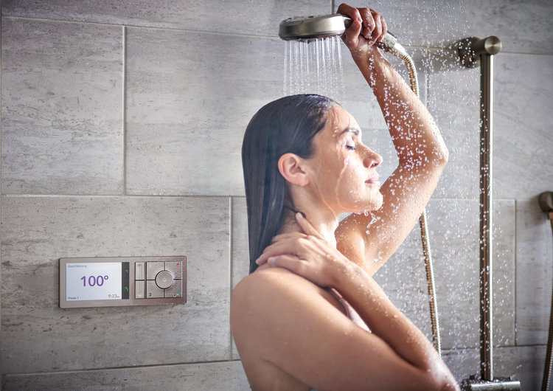

Slide 20
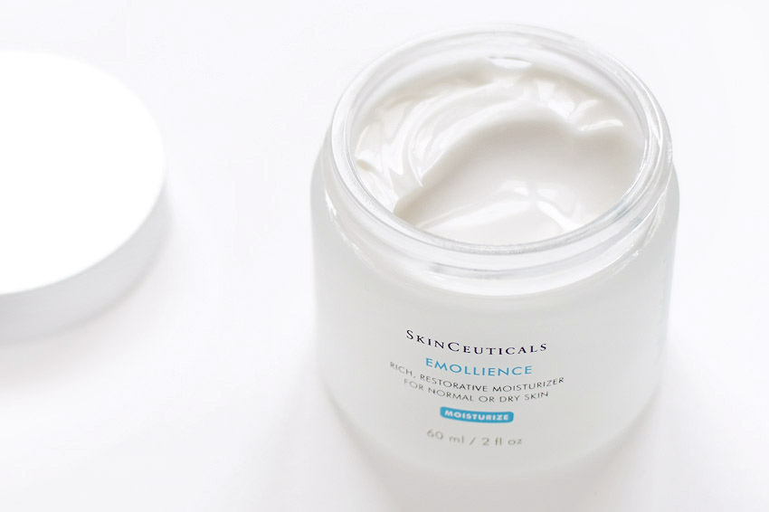
Moisturize
This Photo by Unknown Author is licensed under CC BY-NC-ND

Slide 21
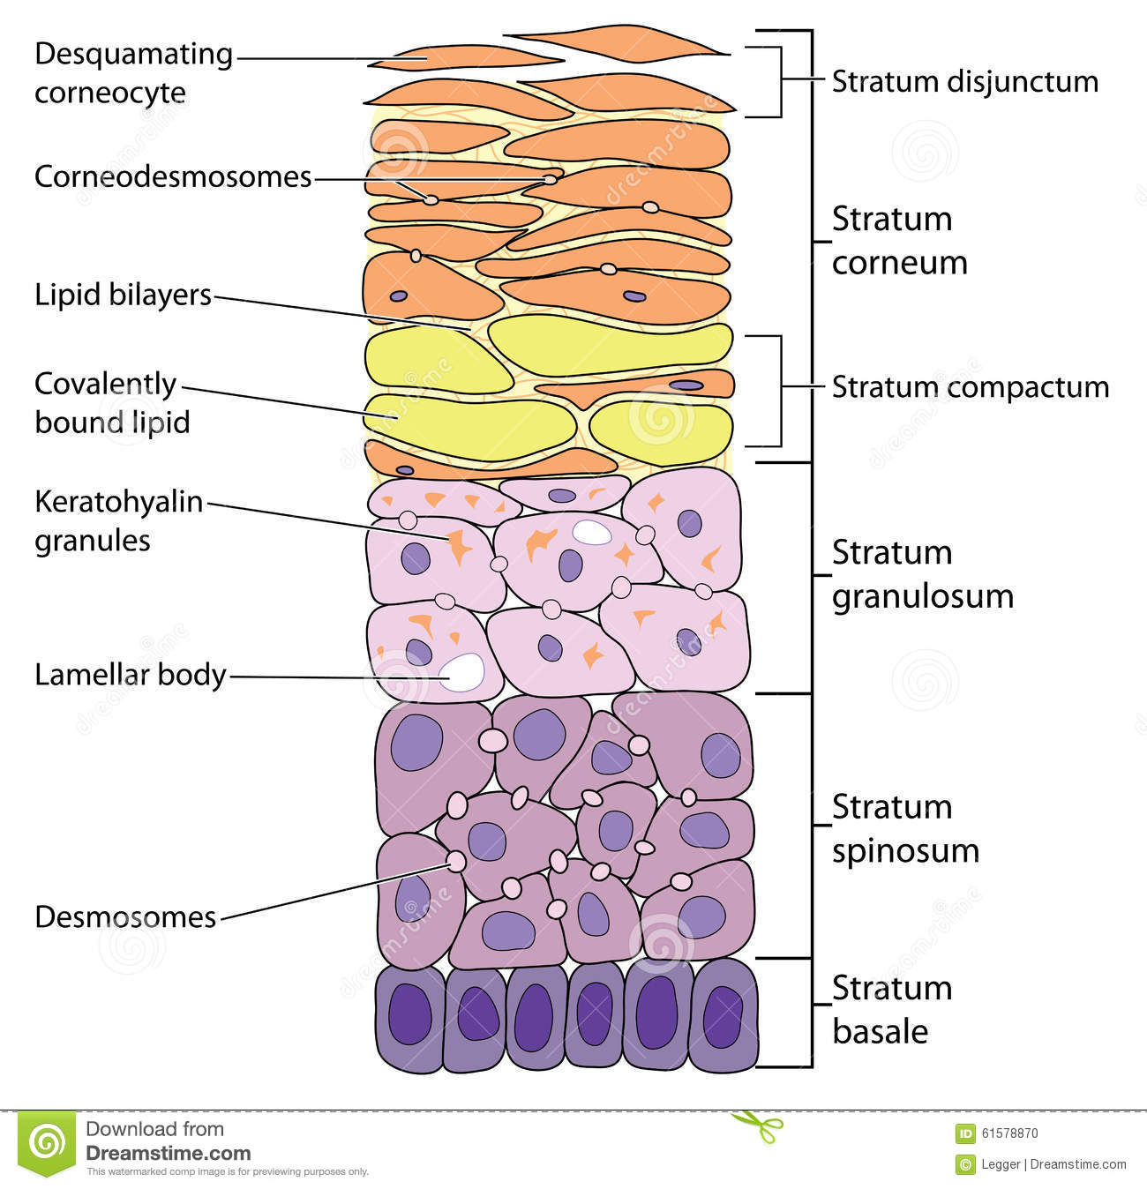

Slide 22
Moisturizers
Block water evaporation
Attract water to the skin
Petrolatum/Vaseline
Mineral oil
Coconut/vegetable oil
Silicone- dimethicone
Glycerin
Urea
Hyaluronic acid
Lactic acid
Propylene glycol

Slide 23
Therapeutic moisturizers-
Petrolatum/Vaseline ointment
Mineral oil, Coconut oil etc
Cetyl alcohol
Silicone- dimethicone, cyclomethicone etc
Glycerin
Urea
Lactic acid
Lanolin, Cetearyl alcohol and sunflower oil (emollients)

Slide 24
Skin cream
Plump
Smooth
Rejuvenate
Glow

Slide 25
Skin cream
Plump
Smooth
Rejuvenate
Glow

Slide 26
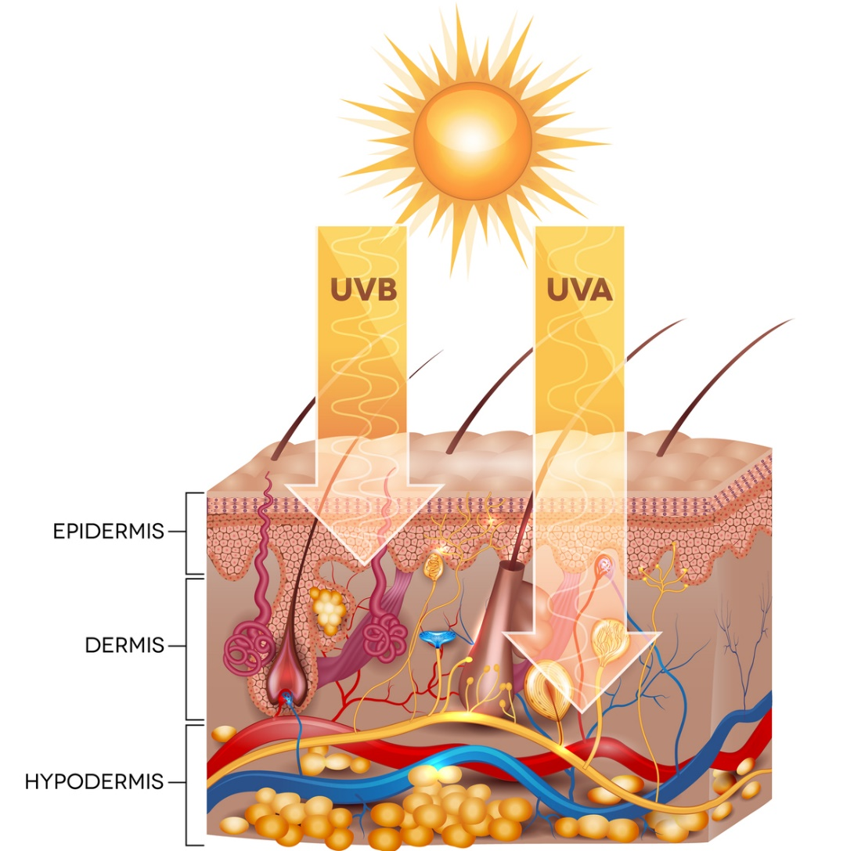
PROTECT- From the harmful rays of the sun
This Photo by Unknown Author is licensed under CC BY-ND

Slide 27
SUNDAMAGE
This Photo by Unknown Author is licensed under CC BY-ND
This Photo by Unknown Author is licensed under CC BY-SA-NC

Slide 28
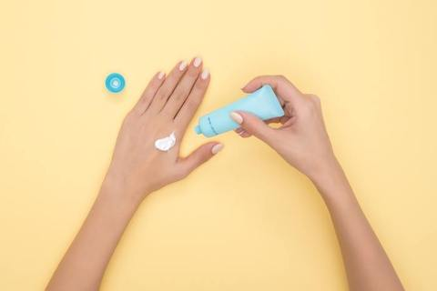
How do sunscreens work?

Slide 29
Sunscreens
Chemical sunscreens
Work as a sponge
Avobenzone
Oxybenzone
Absorb UV radiation.
Easier to rub into the skin
Do not leave a white residue.
Physical sunblocks
Work like a SHIELD
Zinc oxide
Titanium oxide
Better for sensitive skin
Are broad spectrum sunscreens

Slide 30
Where is the evidence?
Sunscreen and Prevention of Skin Aging: A Randomized Trial
Maria Celia B. Hughes, MMedSci; Gail M. Williams, PhD; Peter Baker, PhD; Adèle C. Green, MBBS, PhD. Annals of Internal Medicine, 4 JUNE 2013.
903 adults younger than 53 years; no increase in skin aging over 4.5 years with daily sunscreen use
Nambour Skin cancer prevention trial. 50% reduction in melanoma over 10 years.

Slide 31
How to apply sunscreens?
SPF, Broad spectrum, Waterproof and reapply every 2 hours.

Slide 32
Slip, slop, slap, seek, slide
Stay in the shade.
Slop on the sunscreen with SPF of 50 or more.
Slip on a shirt with UPF 50.
Slap on a hat.
Slide on sunglasses with 100% UV protection.

Slide 33
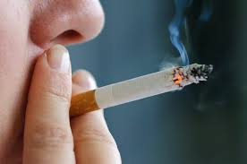
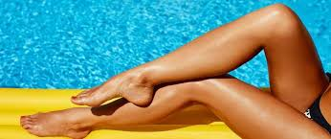
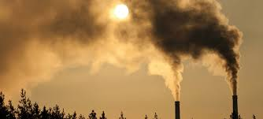
Known to be harmful
Tobacco use
Stress
Tanning beds & Tanning outdoors
Pollution

Slide 35
References:
Leslie Bauman and Edmund Weisberg. Plastic Surgery Vol 2. Aesthetic Surgery, 4th edition.23-37.e4.
A Green et al. Daily sunscreen application and betacarotene supplementation in the prevention of basal cell carcinoma and squamous cell carcinoma of the skin. A randomized control trial. August 28, 1999. The Lancet.
M Celia Hughes et al. Sunscreen and Prevention of Skin Aging: A Randomized trial. June 4, 2013. Annals of Internal Medicine.
https://www.aad.org/public/spot-skin-cancer/learn-about-skin-cancer/detect/what-to-look-for
http://www.sunsmart.com.au/tools/videos/current-tv-campaigns/slip-slop-slap-seek-slide-sid-seagull.html
Gordon JR & Brieva JC, Unilateral dermatoheliosis, N Engl J Med 2012, 366, e25. DOI: 10.1056/NEJMicm1104059.

Slide 36
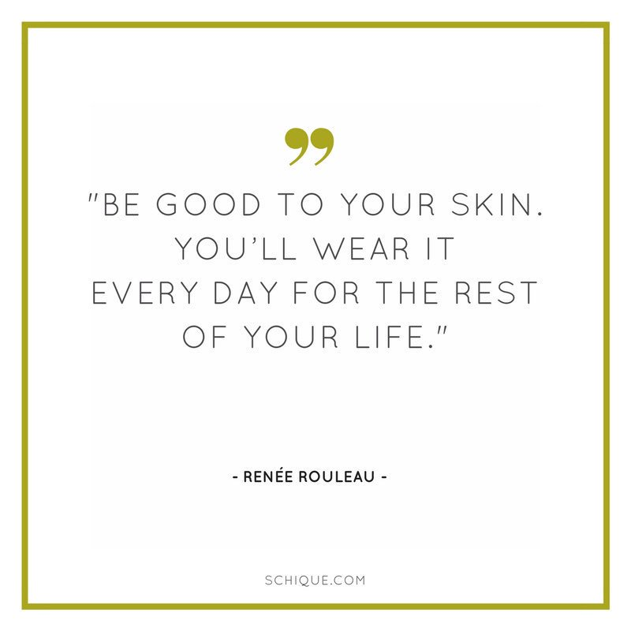

Slide 37
Nambour, Queensland study on sunscreen
 | Group A using sunscreen | Group B usual care
Study group | 812 adults | 809 adults
Melanomas at 10 years | 11 | 22
1625 adults 25-75 years of age.
Subtropical town in Australia
Only used SPF 16.
50% reduction in deadly skin cancer.
4 year study
Control group could use sunscreen

Slide 38
Two Content Layout with SmartArt
First bullet point here
Second bullet point here
Third bullet point here
Group A
Task 1
Task 2
Group B
Task 1
Task 2
Group C
Task 1
Task 2

Slide 39
